Slide 1
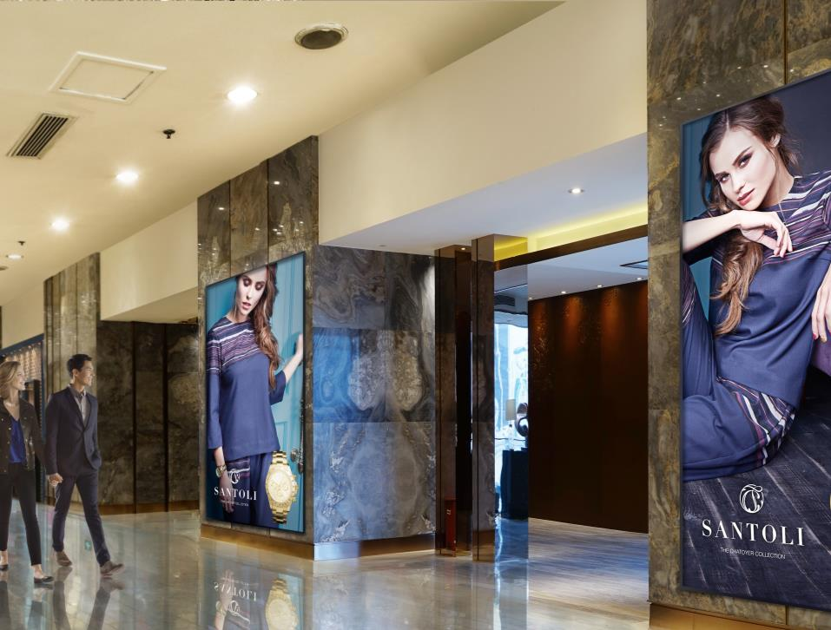
Samsung LFD: Benefits Beyond Features
Q4 2019

Slide 2

Samsung Provides Complete Solutions
What does being the top display brand mean?
With Samsung, there is a built-in brand recognition and trust.
You don’t have to reassure your customer that Samsung is a top company, they will already be familiar with the brand from one of the many verticals Samsung dominates; smartphones, tablets, laptops, memory products, home appliances, sound bars, and of course, displays.
Since the brand is known and celebrated, the job of the reseller then becomes one of selecting the proper solution for the project.

Slide 3
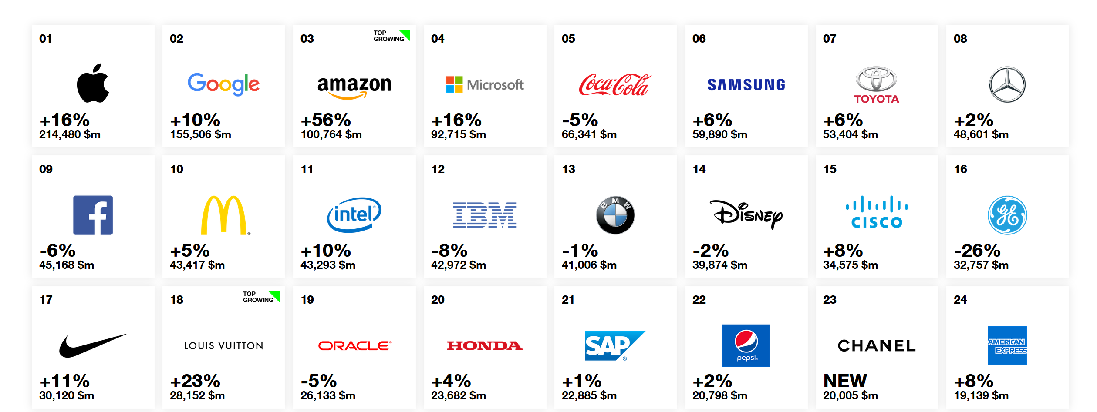
Samsung Global Brand Leadership
2018 Interbrand Brand Rankings shows Samsung #6 among ALL brands!

Slide 4

Vertically Integrated Manufacturing
Samsung manufactures all components and technology built into their LFD solutions, as a true vertically integrated manufacturer.
This means we are not reliant on any other supplier for our display glass, electronics, or components.
This also means that each of the components is specifically engineered to work in concert with each of the other individual components, especially in the area of power supplies and power consumption. This not only relates to increased MTBF, but also power efficiency and the green initiatives that are becoming important.
This vertical integration also includes technology like system on chip, and software solutions, allowing Samsung to provide a streamlined supply chain and availability of product.

Slide 5

Why Choose Samsung?
Top display brand in the world
Fully integrated manufacturer
Most complete product line up, from cost-effective to premium
Best image quality
High brightness, outdoor, and 24/7 options
Thinnest LCD bezels
All-in-one digital signage solutions with SoC
3rd party digital signage application support (SSSP)
Turnkey MagicInfo digital signage
Advanced videowall solutions
Integrated interactive solutions
Comprehensive support and warranty programs
Channel-only focus for distributors and resellers
Broadest range of reseller partners for end users

Slide 6
Why Use Commercial LFD?

Slide 7

Commercial VS. Consumer Displays
One of the big issues facing us today in the audiovisual and digital signage industry is the seeming battle between the use of commercial and consumer displays.
Consumer displays, tend to be lower cost, widely available, and appear to be designed with compelling set of features and capabilities for end users.
So, this begs the question, “Why can’t I just use a less expensive consumer display, for my commercial application?”

Slide 8
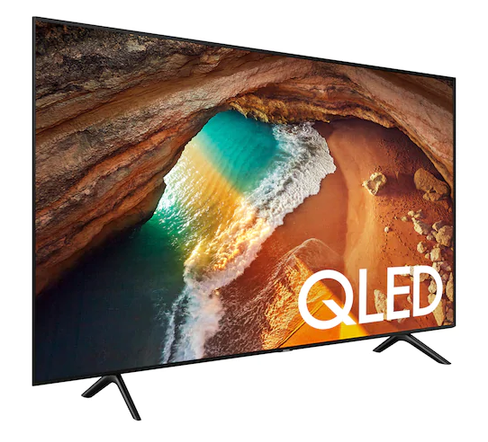
Consumer Displays
Built to run a maximum of 8-10 hours per day, with limited cooling
Focused on HDMI, limited availability of other input types
Limited or no RS232 / IP control
No IR and front panel lock out
No availability of portrait mode
No videowall capabilities
No touch options
No onboard digital signage capabilities
Smaller sizes have over-the-counter warranties
Voided or limited warranty period in commercial installations

Slide 9
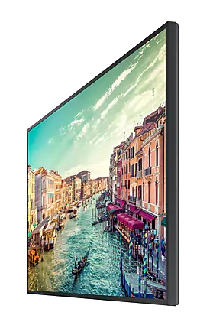
Commercial LFD
More robust construction
Better cooling for a longer MTBF (60K hours avg.)
Built to run from 16/7 up to 24/7 duty cycle
Designed as monitors first, optimized for computer resolutions and video
Expanded input panels with a wider variety of inputs
Higher brightness backlights for flexible applications
Outdoor capable products available
Portrait mode capability
Built in video wall processors
Integrated digital signage platforms
Add on touch overlays
Full RS232 / IP control
IR and remote lock out
3-year warranties on site (extended warranties available)

Slide 10
LFD Product Line Overview

Slide 11
LFD Model Naming Conventions
XY12Z-A
Series
Size
Option
Sub Series or Panel Type
Generation
Series Codes
P: Premium
D: Mainstream
B: Basic
Q: Ultra HD
U: Ultra thin bezel
O: Outdoor
W: Whiteboard
Sub Series
H: High performance
M: Mainstream
B: Basic
E: Edge Lit
D: Direct Lit
Generation Code
D: 2014
E: 2015
F: 2016
H: 2017
J: 2018
N: 2018 / 2019
R: 2019
Option Codes
N: No Wi-Fi
W: Window
D: Dual sided
TR / W: Built-in IR touch
BC: Built in capacitive touch
A: 700 nit backlight
B: 500 nit backlight
U: Ultra narrow bezel
E: Extreme narrow bezel
8K: UHD 8K resolution

Slide 12
Stand Alone LFD
4K / 8K UHD

Slide 13
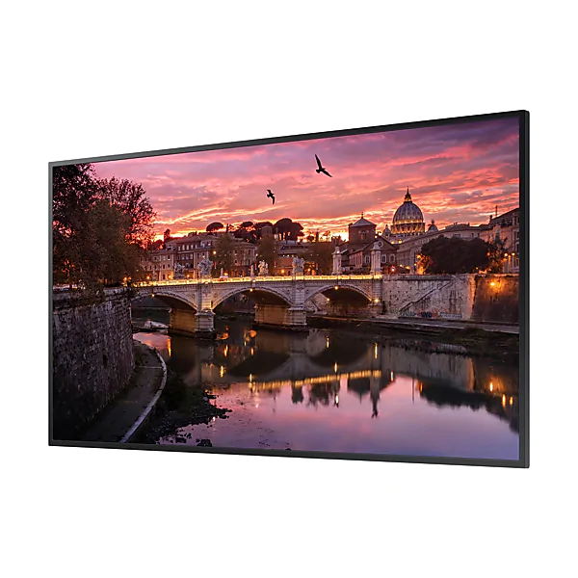

QBR Series
QB43R (43”), QB49R (49”), QB55R (55”), QB65R (65”), QB75R (75”), QB98R (98”)
Entry level, large size, commercial grade 4K UHD LFD.
Example Applications:
High resolution display use
4K digital signage
Key Features:
3840x2160 UHD 4K resolution with Dynamic Crystal Color and HDR10+
350nits 16/7 edge lit LED LFD
9.2MM T/S, 11.2MM B bezel width (43”-65”)
11.5MM T/S, 12.5MM B bezel width (75”)
15.2MM bezel width (98”)
SSSP 6.0 / S6 Player (SoC) onboard with Tizen 4.0
Wi-Fi and Bluetooth onboard
Integrated Miracast screen mirroring and Remote Workspace IP5X rating for dust
Notes:
Additional Specs
Gloss screen surface (2% haze)
1.9” chassis depth (2.96” for 98”)
Integrated speakers
NO TUNER
DVI-D, HDMI 2.0 / HDCP 2.2 (2) inputs (QB98R adds DisplayPort 1.2)
NO VIDEOWALL LOOP THROUGH
Ethernet and Wi-Fi networking
Full RS232 and IP control
3-year onsite commercial warranty
QB98R SHARES QMN CHASSIS

Slide 14
QBR-N Series
QB55R-N (55”), QB65R-N (65”), QB75R-N (75”)
Entry level, large size, commercial grade 4K UHD LFD.
No wireless for sensitive applications.
Example Applications:
High resolution display use
4K digital signage
Key Features:
3840x2160 UHD 4K resolution with Dynamic Crystal Color and HDR10+
350nits 16/7 edge lit LED LFD
9.2MM T/S, 11.2MM B bezel width (55”-65”)
11.5MM T/S, 12.5MM B bezel width (75”)
SSSP 6.0 / S6 Player (SoC) onboard with Tizen 4.0
NO Wi-Fi / Bluetooth onboard
Integrated Remote Workspace
IP5X rating for dust
Notes:
Additional Specs
Gloss screen surface (2% haze)
1.9” chassis depth
Integrated speakers
NO TUNER
DVI-D, HDMI 2.0 / HDCP 2.2 (2) inputs
NO VIDEOWALL LOOP THROUGH
Ethernet networking ONLY
Full RS232 and IP control
3-year onsite commercial warranty

Slide 15
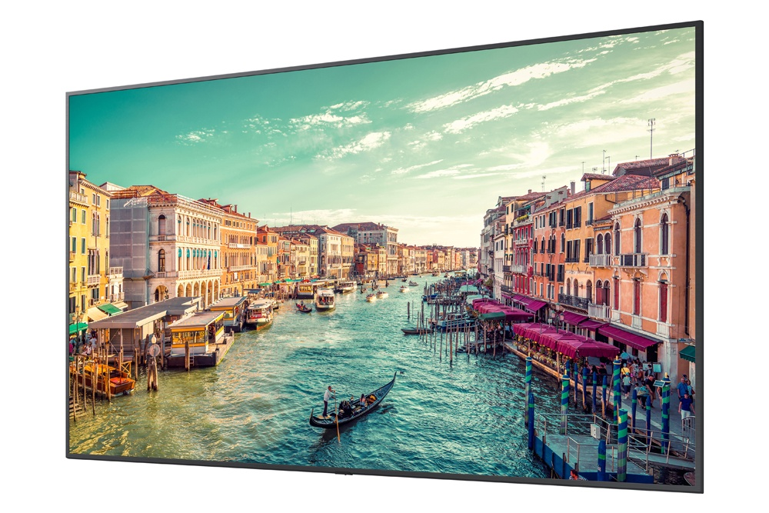
QER Series
QE82R (82”)
Prosumer style, low cost commercial grade 4K UHD LFD.
Example Applications:
High resolution display use
4K digital signage
Key Features:
3840x2160 UHD 4K resolution with Dynamic Crystal Color.
350nits 16/7 edge lit LED LFD
10.8MM T/S, 10.9MM B bezel width
Wi-Fi and Bluetooth onboard
Integrated Miracast screen mirroring and Remote Access
SSSP 7.0 / S7 Player with Tizen 5.0
Notes:
Additional Specs
Gloss screen surface (2% haze)
2.4” chassis depth
Integrated speakers
NO TUNER
HDMI 2.0 / HDCP 2.2 (2), DVI-D, DisplayPort 1.2
Full RS232 and IP control
3-year onsite commercial warranty

Slide 16
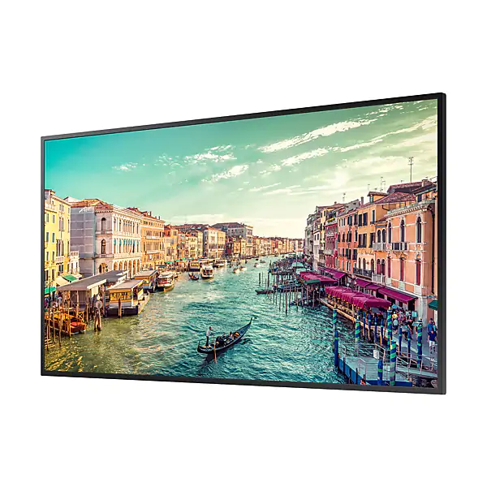
QMR Series
QM43R (43”), QM49R (49”), QM55R (55”), QM65R (65”), QM75R (75”)
Mainstream commercial grade 4K UHD LFD.
Example Applications:
High resolution display use
4K digital signage
Key Features:
3840x2160 UHD 4K resolution with Dynamic Crystal Color and HDR10+
500nits 24/7 edge lit LED LFD
9.2MM T/S, 11.2MM B bezel width (43”-65”)
11.5MM T/S, 12.5MM B bezel width (75”)
SSSP 6.0 / S6 Player (SoC) onboard with Tizen 4.0
Wi-Fi and Bluetooth onboard
Integrated Miracast screen mirroring and Remote Workspace
IP5X rating for dust
Notes:
Additional Specs
Non glare screen surface (44% haze 43”/75”, 25% haze 49” / 55” / 65”)
1.9” chassis depth
Integrated speakers
NO TUNER
DVI-D, DisplayPort 1.2, HDMI 2.0 / HDCP 2.2 (2) inputs
HDMI loop through (HDCP 2.2 up to 4, HDCP 1.4 up to 7)
Ethernet and Wi-Fi networking
Full RS232 and IP control
3-year onsite commercial warranty

Slide 17
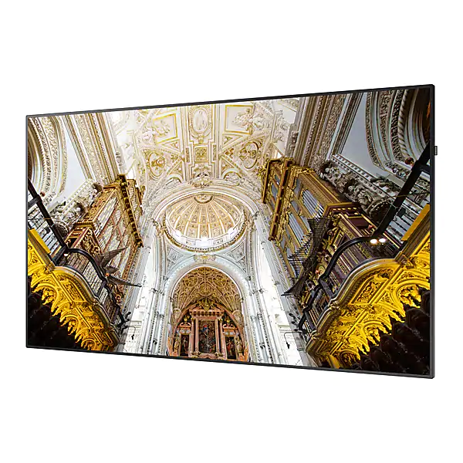
QMN Series
QM85N (85”), QM98N (98”)
True commercial grade, large size 4K UHD LFD.
Example Applications:
High resolution display use
4K digital signage
Key Features:
3840x2160 UHD 4K resolution
500nits 24/7 edge lit LED LFD
3.2mm T/S, 19.3mm B (85”)
15.2mm bezel width (98”)
SSSP 6.0 / S6 Player (SoC) onboard with Tizen 4.0
Wi-Fi and Bluetooth onboard with integrated Miracast screen mirroring
Notes:
Additional Specs
Non glare screen surface (44% haze 85” , 25% haze 98”)
85” – 4.14” chassis depth
98” – 2.96” chassis depth
Integrated speakers
NO TUNER
HDMI loop through (HDCP 2.2 up to 4, HDCP 1.4 up to 7)
DVI-D, HDMI 2.0 / HDCP 2.2 (2), DisplayPort 1.2 inputs
Ethernet and Wi-Fi networking
Full RS232 and IP control
3-year onsite commercial warranty

Slide 18
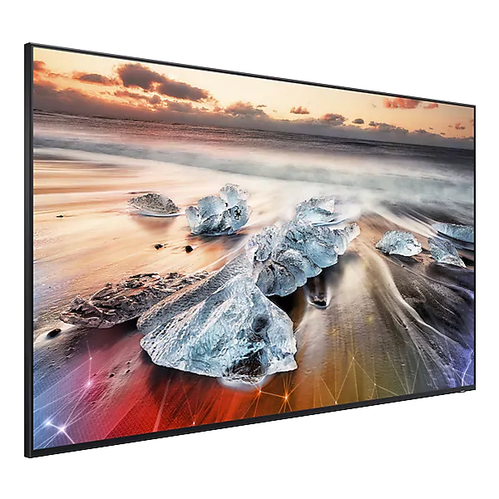
QPR-8K Series
QP82R-8K (82”), QP98R-8K (98”)
8K high performance QLED LFD.
Example Applications:
Highest resolution display use
High brightness, color performance, HDR
8K imaging
Key Features:
7680x4320 8K UHD resolution with AI Upscaling
120Hz QLED LFD with 100% color volume, HDR10+, and 500nits / 4000nits peak brightness
16/7 duty cycle
3 side bezel-less design (consumer style)
SSSP 7.0 / S7 Player (SoC) onboard with Tizen 5.0
Wi-Fi and Bluetooth onboard with integrated Miracast screen mirroring and Remote Access
OneConnect Box for power and inputs
Notes:
Additional Specs
Gloss screen surface (0% haze)
1.3” 82”, 1.57” 98” chassis depth
Integrated speakers
NO TUNER
HDMI 2.0 / HDCP 2.2 (4), DisplayPort 1.2 inputs
Wi-Fi and Ethernet networking
Full RS232 and IP control
3-year onsite commercial warranty
TABLE STAND INCLUDED

Slide 19
Stand Alone LFD
1080P FHD

Slide 20
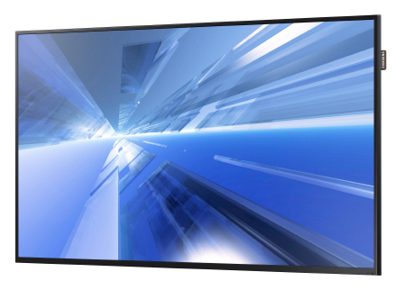
DCE Series
DC32E (32”), DC55E (55”)
Cost-effective LFD, for applications requiring basic features with full commercial grade quality and durability. Includes integrated free MagicInfo Lite digital signage.
Example Applications:
Entry level digital signage
Basic LFD use – display of video sources
Key Features:
1920x1080 Full HD resolution
350 nit (330 nit 32”) direct lit 16/7 LED LFD
10.5mm (top / side, 9.5 55”) 15mm (bottom) bezel width
Simple SoC onboard (Compatible with Lite Only)
Notes:
Additional Specs:
Gloss screen surface (2% matte)
2” chassis depth
Integrated speaker
Integrated tuner (NTSC/ATSC/Clear QAM)
HDMI (2), DVI, VGA, Comp./CVBS inputs
Ethernet networking
Full RS232 control
3-year onsite commercial warranty
No Wi-Fi onboard

Slide 21
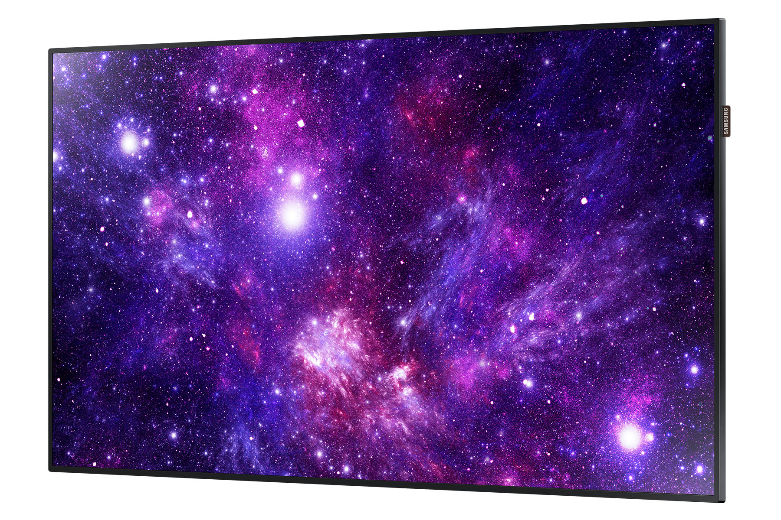
DCJ Series
DC43J (43”), DC49J (49”)
Cost-effective LFD, for applications requiring basic features with full commercial grade quality and durability. Includes integrated free MagicInfo Lite digital signage.
Example Applications:
Entry level digital signage
Basic LFD use – display of video sources
Key Features:
1920x1080 Full HD resolution
300 nit direct lit 16/7 LED LFD
43” – 17.3mm T, 18.3mm B, 21.3mm S bezel width
49” – 17.4mm T, 18.5mm B, 21.5mm S bezel width
Simple SoC onboard (Compatible with Lite Only)
Notes:
Additional Specs:
Gloss screen surface (2% matte)
2.8” (2.9” 49”) chassis depth
Integrated speaker
Integrated tuner (NTSC/ATSC/Clear QAM)
HDMI (2), DVI, VGA, Comp./CVBS inputs
Ethernet networking
Full RS232 control
3-year onsite commercial warranty
No Wi-Fi onboard

Slide 22
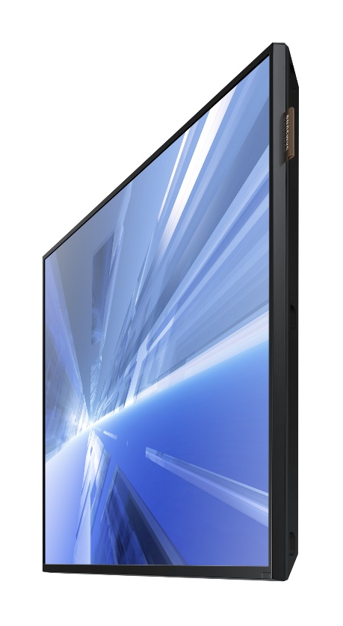
DBE Series
DB32E (32”)
Mainstream, general purpose LFD for applications requiring more advanced features at a lower cost. Includes embedded SoC (System on a Chip) media player.
Example Applications:
Turnkey digital signage
Basic LFD / commercial TV use – display of video sources
Key Features:
1920x1080 Full HD resolution
350 nit slim direct lit 16/7 LED display
10.5mm (top / side) 15mm (bottom) bezel width
SSSP 3.0 / S3 Player (SoC) onboard
Wi-Fi onboard with integrated Miracast screen mirroring
Notes:
Additional Specs
Gloss screen surface (2% matte)
2” chassis depth
Integrated TV Tuner (NTSC/ATSC/Clear QAM)
Integrated speakers
VGA, DVI, HDMI, Comp./CVBS inputs
Wi-Fi and Ethernet networking
Full RS232 control
Videowall processor
Videowall loop through (DisplayPort)
3-year onsite commercial warranty
SD Card Slot for Memory Upgrade

Slide 23
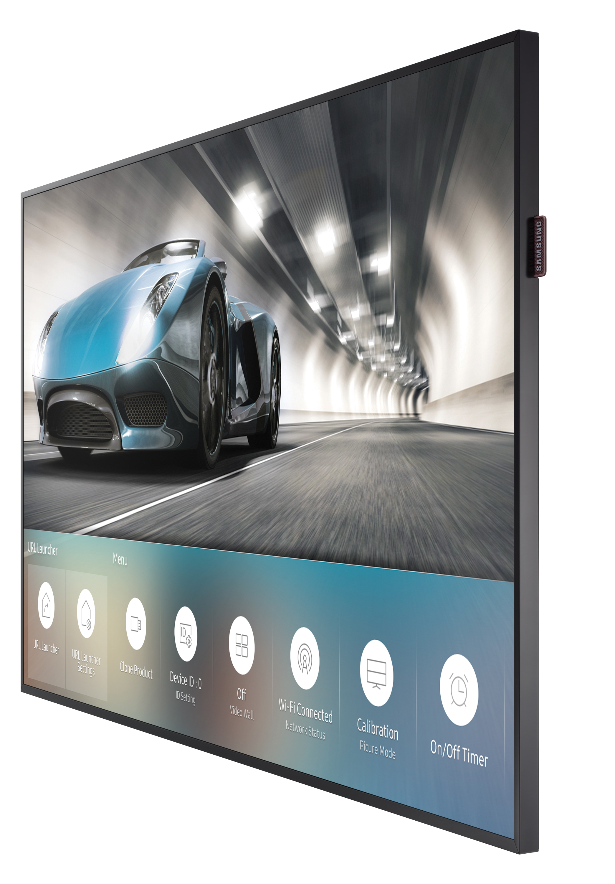
PMF Series
PM32F (32”)
Advanced LFD for applications requiring comprehensive features. Includes the 4th generation Tizen based SoC (System on a Chip) media player.
Example Applications:
Turnkey digital signage
General display use
Key Features:
1920x1080 Full HD resolution
400 nit edge lit 16/7 LED display
8.9mm bezel width
SSSP 4.0 / S4 Player (SoC) onboard
Wi-Fi onboard with integrated Miracast screen mirroring
IP5X rated for dust
Notes:
Additional Specs
Matte screen surface (44% matte)
1.2” chassis depth
Integrated TV Tuner (NTSC/ATSC/Clear QAM)
Integrated speakers
VGA, DVI, HDMI 2.0 (2), DisplayPort 1.2 (2) inputs
Full RS232 control
Videowall processor
Videowall loop through (DisplayPort)
3-year onsite commercial warranty
Center glass IR receiver

Slide 24
PMH Series
PM43H (43”), PM49H (49”), PM55H (55”)
Advanced 24/7 rated LFD for applications requiring comprehensive features. Includes the newest 4th generation Tizen based SoC (System on a Chip) media player.
Example Applications:
Turnkey digital signage
General display use
24/7 display use
Key Features:
1920x1080 Full HD resolution
500 nit edge lit 24/7 LED display
9.0mm (top / side), 11mm (bottom) bezel width
SSSP 4.0 / S4 Player (SoC) onboard
Wi-Fi onboard with integrated Miracast screen mirroring
IP5X rated for dust
Notes:
Additional Specs
Matte screen surface (44% matte)
1.2” chassis depth
Integrated TV Tuner (NTSC/ATSC/Clear QAM)
Integrated speakers
VGA, DVI, HDMI 2.0 (2), DisplayPort 1.2 (2) inputs
Full RS232 control
Videowall processor
Videowall loop through (DisplayPort)
3-year onsite commercial warranty
Center glass IR receiver

Slide 25
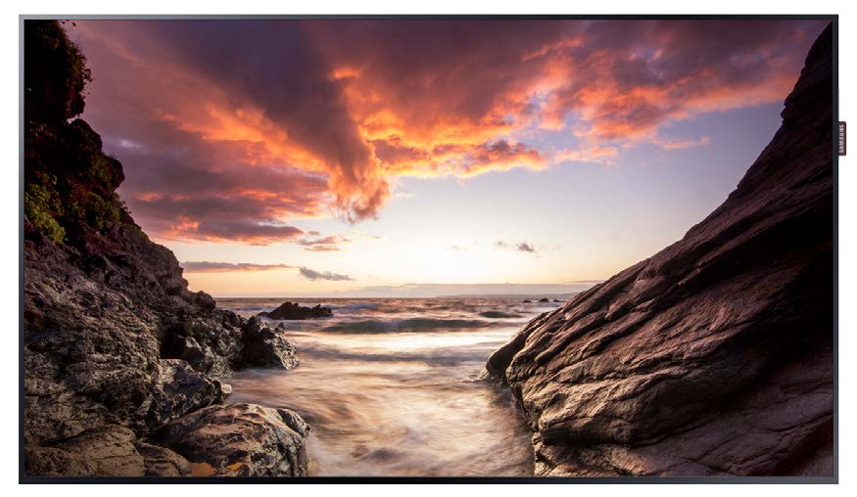
PHF-P Series
PH43F-P (43”), PH49F-P (49”), PH55F-P (55”)
Advanced higher brightness 24/7 rated LFD for applications requiring comprehensive features. Includes the newest 4th generation Tizen based SoC (System on a Chip) media player.
Example Applications:
Turnkey digital signage
General display use
24/7 higher brightness display use
Key Features:
1920x1080 Full HD resolution
700 nit edge lit 24/7 LED display
6.9mm (top / side), 8.9mm (bottom) bezel width
SSSP 4.0 / S4 Player (SoC) onboard
Wi-Fi onboard with integrated Miracast screen mirroring
IP5X rated for dust
Notes:
Additional Specs
Matte screen surface (44% matte)
1.2” chassis depth
Integrated TV Tuner (NTSC/ATSC/Clear QAM)
Integrated speakers
VGA, DVI, HDMI 2.0 (2), DisplayPort 1.2 (2) inputs
Full RS232 control
Videowall processor
Videowall loop through (DisplayPort)
3-year onsite commercial warranty
Center glass IR receiver

Slide 26
Videowall LFD

Slide 27
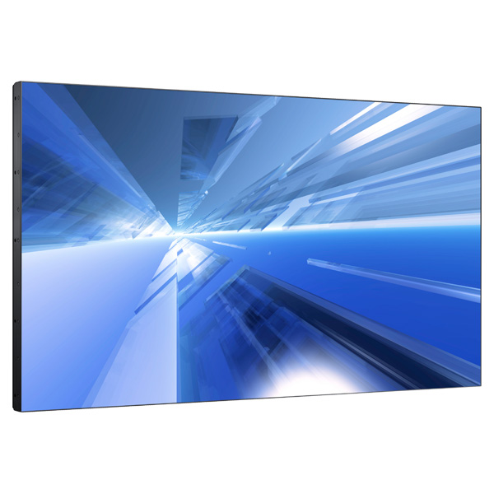
UHF5 Series
UH46F5 (46”)
Super narrow bezel, thin profile videowall LFD solution, with 4K UHD daisy chain capability.
Key Features:
1920x1080 Full HD resolution
700 nit direct lit 24/7 LED display
Ultra-slim 3.4mm bezel (top / left) 2.0mm (bottom / right) for 5.4mm B to B
Advanced Color Management (ACM)
Integrated videowall processor with loop through
Loop through supports up to 4K UHD input resolution (5x5)
No SoC onboard
Notes:
Additional Specs
Matte screen surface (11% haze)
1.9” chassis depth
DVI-D, DisplayPort, Component, HDMI inputs
Videowall processor up to 15x15
Videowall loop through (DisplayPort) up 10x10 in 1080P with HDCP support (up to 7)
RS232 and IR loop through
Full RS232 and IP control
3-year onsite commercial warranty

Slide 28
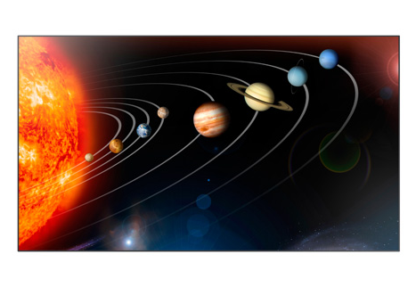
UDE-B Series
UD46E-B (46”), UD55E-B (55”)
Ultra-narrow bezel high performance videowall LFD solution, with 4K UHD daisy chain capability. Lower screen brightness for more cost effectiveness.
Key Features:
1920x1080 Full HD resolution
500 nit direct lit 24/7 LED display
Ultra-slim 1.75mm bezel (3.5mm B to B)
Advanced Color Management (ACM)
Integrated videowall processor with loop through
Loop through supports up to 4K UHD input resolution (5x5)
No SoC onboard
Notes:
Additional Specs
Matte screen surface (44% haze)
3.8” chassis depth
VGA, DVI, DisplayPort, Component, HDMI inputs
Videowall processor up to 15x15
Videowall loop through (DisplayPort) up 10x10 in 1080P with HDCP support (up to 7)
RS232 and IR loop through
Full RS232 and IP control
3-year onsite commercial warranty

Slide 29
UDE-A Series
UD46E-A (46”), UD55E-A (55”)
Ultra-narrow bezel high performance videowall LFD solution, with 4K UHD daisy chain capability.
Key Features:
1920x1080 Full HD resolution
700 nit direct lit 24/7 LED display
Ultra-slim 1.75mm bezel (3.5mm B to B)
Advanced Color Management (ACM)
Integrated videowall processor with loop through
Loop through supports up to 4K UHD input resolution (5x5)
No SoC onboard
Notes:
Additional Specs
Matte screen surface (44% haze)
3.8” chassis depth
VGA, DVI, DisplayPort, Component, HDMI inputs
Videowall processor up to 15x15
Videowall loop through (DisplayPort) up 10x10 in 1080P with HDCP support (up to 7)
RS232 and IR loop through
Full RS232 and IP control
3-year onsite commercial warranty

Slide 30
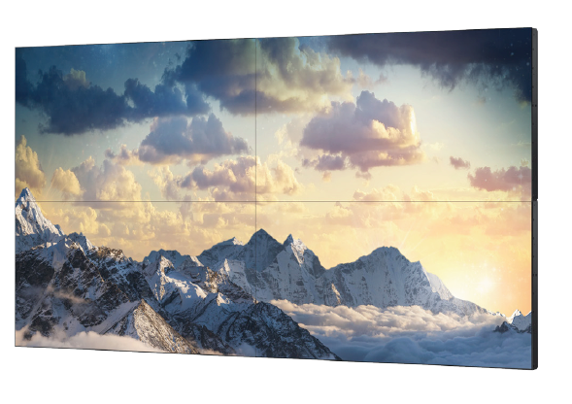
UMN-E Series
UM46N-E (46”)
Extreme narrow bezel high performance videowall LFD solution, with 4K UHD daisy chain capability.
Key Features:
1920x1080 Full HD resolution
500 nit direct lit 24/7 LED display
Ultra-slim 1.15mm bezel (top / left) 0.55mm (bottom / right) for 1.7mm B to B
Advanced Color Management (ACM)
Integrated videowall processor with loop through
Loop through supports up to 4K UHD input resolution (5x5)
No SoC onboard
Notes:
Additional Specs
Matte screen surface (44% haze)
3.8” chassis depth
VGA, DVI, DisplayPort, Component, HDMI inputs
Videowall processor up to 15x15
Videowall loop through (DisplayPort) up 10x10 in 1080P with HDCP support (up to 7)
RS232 and IR loop through
Full RS232 and IP control
3-year onsite commercial warranty

Slide 31
UMH-E Series
UM55F-E (55”)
Extreme narrow bezel high performance videowall LFD solution, with 4K UHD daisy chain capability.
Key Features:
1920x1080 Full HD resolution
500 nit direct lit 24/7 LED display
Ultra-slim 1.15mm bezel (top / left) 0.55mm (bottom / right) for 1.7mm B to B
Advanced Color Management (ACM)
Integrated videowall processor with loop through
Loop through supports up to 4K UHD input resolution (5x5)
No SoC onboard
Notes:
Additional Specs
Matte screen surface (44% haze)
3.8” chassis depth
VGA, DVI, DisplayPort, Component, HDMI inputs
Videowall processor up to 15x15
Videowall loop through (DisplayPort) up 10x10 in 1080P with HDCP support (up to 7)
RS232 and IR loop through
Full RS232 and IP control
3-year onsite commercial warranty

Slide 32
UHN-E Series
UH46N-E (46”)
Extreme narrow bezel high performance videowall LFD solution, with 4K UHD daisy chain capability.
Key Features:
1920x1080 Full HD resolution
700 nit direct lit 24/7 LED display
Ultra-slim 1.15mm bezel (top / left) 0.55mm (bottom / right) for 1.7mm B to B
Advanced Color Management (ACM)
Integrated videowall processor with loop through
Loop through supports up to 4K UHD input resolution (5x5)
No SoC onboard
Notes:
Additional Specs
Matte screen surface (44% haze)
3.8” chassis depth
VGA, DVI, DisplayPort, Component, HDMI inputs
Videowall processor up to 15x15
Videowall loop through (DisplayPort) up 10x10 in 1080P with HDCP support (up to 7)
RS232 and IR loop through
Full RS232 and IP control
3-year onsite commercial warranty

Slide 33
UHF-E Series
UH55F-E (55”)
Extreme narrow bezel high performance videowall LFD solution, with 4K UHD daisy chain capability.
Key Features:
1920x1080 Full HD resolution
700 nit direct lit 24/7 LED display
Ultra-slim 1.15mm bezel (top / left) 0.55mm (bottom / right) for 1.7mm B to B
Advanced Color Management (ACM)
Integrated videowall processor with loop through
Loop through supports up to 4K UHD input resolution (5x5)
No SoC onboard
Notes:
Additional Specs
Matte screen surface (44% haze)
3.8” chassis depth
VGA, DVI, DisplayPort, Component, HDMI inputs
Videowall processor up to 15x15
Videowall loop through (DisplayPort) up 10x10 in 1080P with HDCP support (up to 7)
RS232 and IR loop through
Full RS232 and IP control
3-year onsite commercial warranty

Slide 34
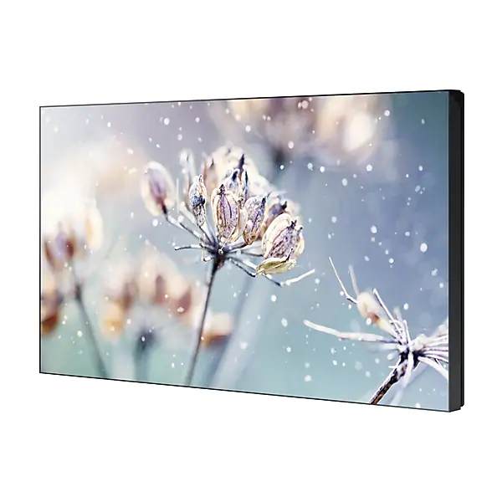
VMR-U Series
VM46R-U (46”)
Ultra narrow bezel, thin profile videowall LFD solution, with 4K UHD daisy chain capability.
Key Features:
1920x1080 Full HD resolution
500 nit direct lit 24/7 LED display
2.3mm bezel (top / left) 1.2mm (bottom / right) for 3.5mm B to B
Advanced Color Management (ACM)
Integrated videowall processor with loop through
Loop through supports up to 4K UHD input resolution (up to 9)
SSSP 6.0 / S6 Player (SoC) onboard with Tizen 4.0
Notes:
Additional Specs
Matte screen surface (25% haze)
3.83” chassis depth
DisplayPort 1.2, HDMI 2.0 / HDCP 2.2 (2) inputs
Videowall processor up to 15x15
Videowall loop through (HDMI) up to 9 with HDCP support
RS232 and IR loop through
Full RS232 and IP control
3-year onsite commercial warranty

Slide 35
Outdoor / Semi- Outdoor LFD

Slide 36
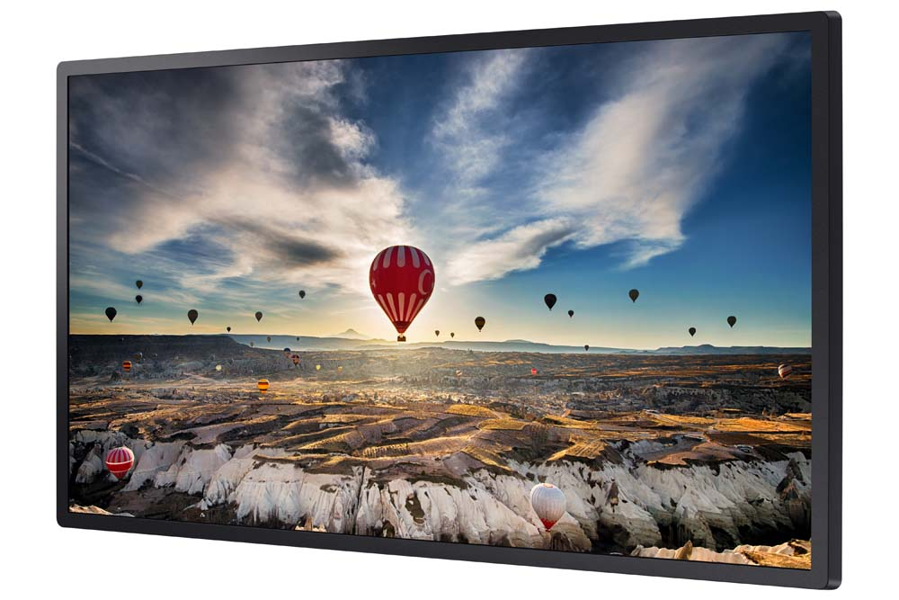
OMH Series
OM32H (32”)
High brightness LFD for non-IP rated applications (including videowalls), dealing with high ambient light.
Example Applications:
Brightly lit atriums
Well lit lobbies
Retail store windows
Key Features:
1920x1080 Full HD resolution
1000 nit 16/7 direct lit LED LFD
14mm bezel width
SSSP 4.0 / S4 Player (SoC) onboard
Not outdoor IP rated, intended for indoor sunlight use
Notes:
Additional Specs:
Gloss screen surface (0% haze)
Polarized for sunglasses use
2.1” chassis depth
NO SPEAKERS
NO TUNER
DisplayPort (1), HDMI (2), HDBaseT inputs
Videowall processor up to 15x15
Videowall loop through (DisplayPort) up 10x10 in 1080P with HDCP support (up to 7)
RS232 and IR loop through
Full RS232 and IP control
Ethernet networking
3-year onsite commercial warranty

Slide 37
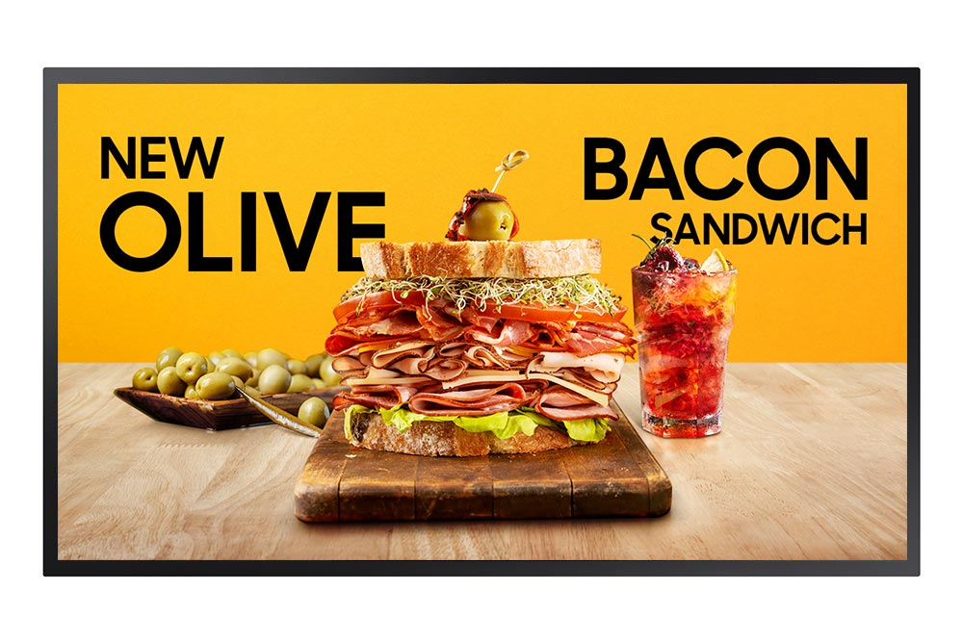
OMN Series
OM46N (46”), OM55N (55”)
High brightness LFD for non-IP rated applications (including videowalls), dealing with high ambient light.
Example Applications:
Brightly lit atriums
Well lit lobbies
Retail store windows
Key Features:
1920x1080 Full HD resolution
4000 nit 24/7 edge lit LED LFD
19.9mm bezel width
SSSP 6.0 / S6 Player (SoC) onboard with Tizen 4.0
Wi-Fi onboard
IP5X rated against dust
Not outdoor IP rated, intended for indoor sunlight use
Notes:
Additional Specs:
Gloss screen surface (0% haze)
Polarized for sunglasses use
2.1” chassis depth
NO SPEAKERS
NO TUNER
Videowall processor up to 15x15
Videowall loop through (HDMI) up 10x10 in 1080P with HDCP support (up to 7)
RS232 and IR loop through
Full RS232 and IP control
Ethernet and wireless networking
3-year onsite commercial warranty

Slide 38
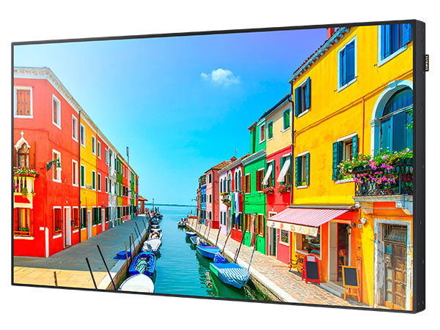
OMD-W Series
OM75D-W (75”)
High brightness LFD for non-IP rated applications (including videowalls), dealing with high ambient light.
Example Applications:
Brightly lit atriums
Well lit lobbies
Retail store windows
Key Features:
1920x1080 Full HD resolution
2500 nit 24/7 direct lit LED LFD
11.7mm bezel width
SSSP 2.0 / S2 Player (SoC) onboard
Wi-Fi onboard
Not outdoor IP rated, intended for indoor sunlight use
Notes:
Additional Specs:
Gloss screen surface (0% haze)
Polarized for sunglasses use
5” chassis depth
Built in speakers
NO TUNER
Videowall processor up to 15x15
Videowall loop through (DisplayPort) up 10x10 in 1080P with HDCP support (up to 7)
RS232 and IR loop through
Full RS232 and IP control
Wi-Fi and Ethernet networking
3-year onsite commercial warranty

Slide 39
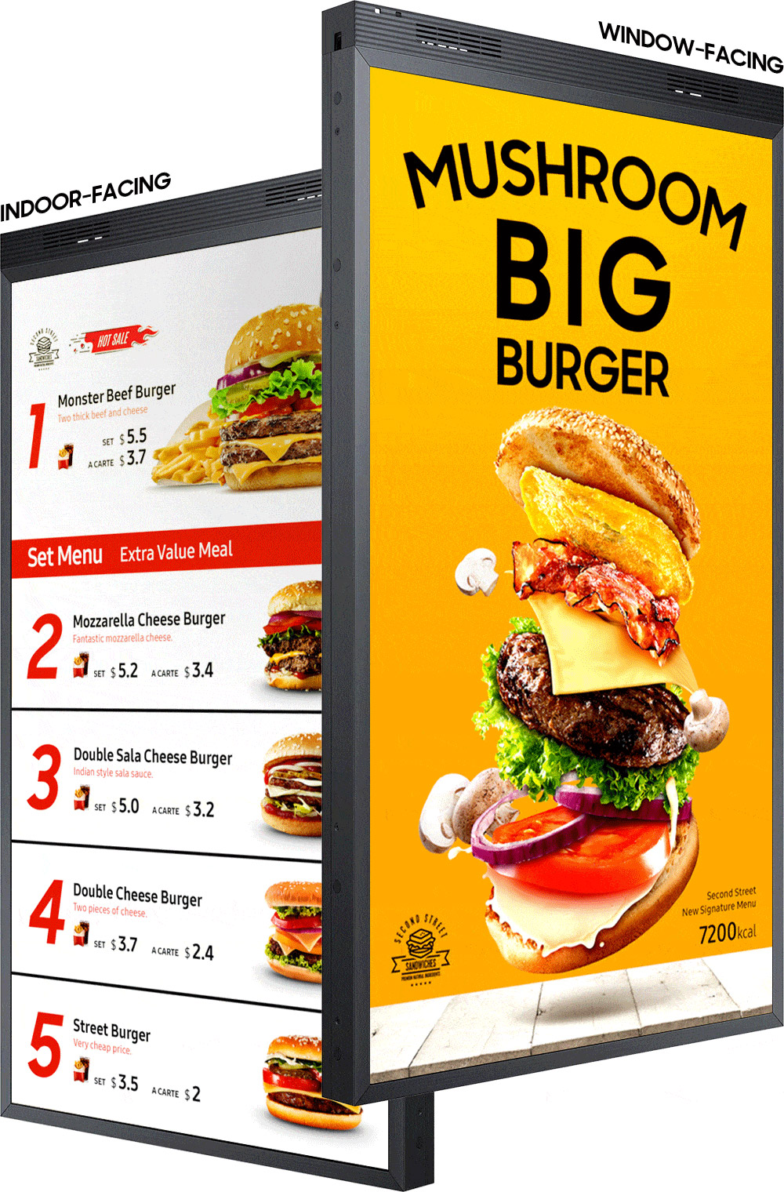
OMN-D Series
OM46N-D (46”), OM55N-D (55”)
High brightness DUAL SIDED LFD for non-IP rated applications, dealing with high ambient light.
Example Applications:
Brightly lit atriums
Well lit lobbies
Retail store windows
Key Features:
PORTRAIT ONLY
1920x1080 Full HD resolution
3000 nit (front) / 1000 nit (back) 24/7 edge lit LED LFD
22.8mm bezel width
SSSP 6.0 / S6 Player (SoC) onboard with Tizen 4.0
Wi-Fi onboard
IP5X rated against dust
Not IP rated, intended for indoor sunlight use
Notes:
Additional Specs:
Gloss screen surface (0% haze)
Polarized for sunglasses use
2.7” chassis depth
NO SPEAKERS
NO TUNER
HDMI (2) inputs
SEPARATE INPUTS AND SOC PER SIDE
Wi-Fi and Ethernet networking
Full RS232 and IP control
3-year onsite commercial warranty
SBB module support

Slide 40
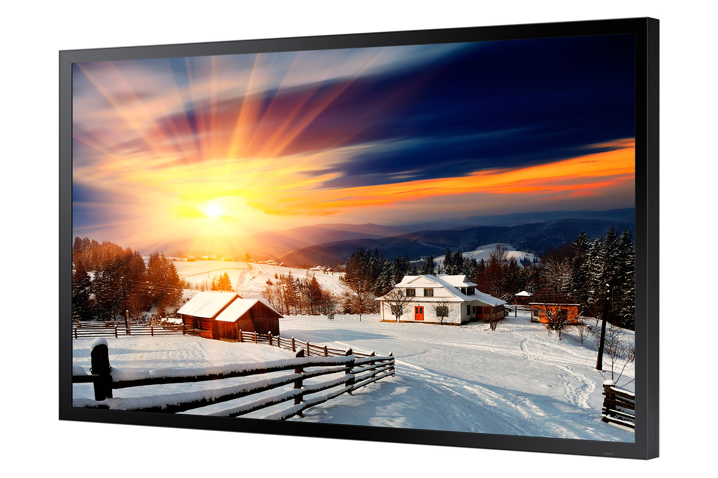
OHF Series
OH46F (46”), OH55F (55”), OH75F (75”), OH85F (85”)
Fully enclosed, IP rated high brightness LFD for applications dealing with high ambient light, that does not require a separate enclosure.
Example Applications:
Wayfinding outdoors
Digital signage for theme parks / sports venues / garages
Train / subway stations
Key Features:
1920x1080 Full HD resolution (85” 4K UHD)
2500 nit 24/7 direct lit LED LFD
24.9mm (75” 59.8mm , 85” 62mm) bezel width
SSSP 4.0 / S4 Player (SoC) onboard
IP56 rated
Tempered armor glass front for impact resistance
Notes:
Additional Specs
Gloss screen surface (protective glass)
3.35” chassis depth (75” and 85” 4.72”)
NO SPEAKERS
NO TUNER
HDMI 1.4 (2) HDBaseT, 85” DP 1.2 (2)
Ethernet networking
NO WI-FI ONBOARD
Full RS232 and IP control
3-year onsite commercial warranty

Slide 41
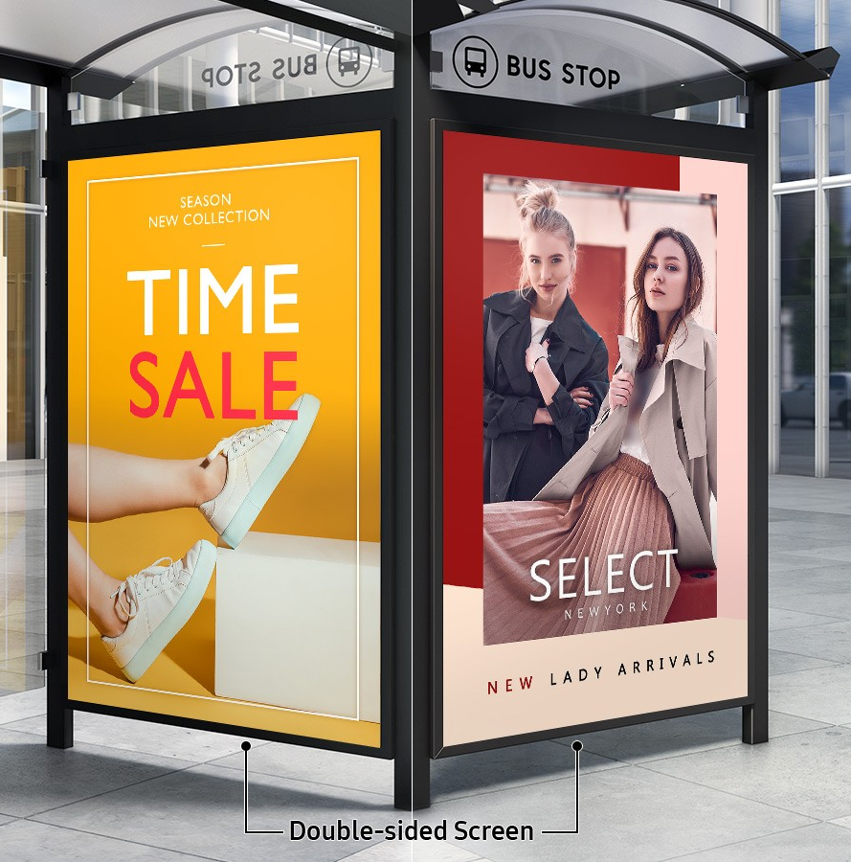
OHN-D Series
OH85N-D (85”)
Fully enclosed, IP rated high brightness DUAL SIDED LFD for applications dealing with high ambient light, that does not require a separate enclosure.
Example Applications:
Wayfinding outdoors
Digital signage for theme parks / sports venues / garages
Train / subway stations
Key Features:
3840x2160 4K UHD resolution
3300 nit 24/7 direct lit LED LFD
62mm bezel width
SSSP 6.0 / S6 Player (SoC) onboard with Tizen 4.0
IP56 rated
Tempered armor glass front for impact resistance
Notes:
Additional Specs
Gloss screen surface (protective glass)
9” chassis depth
NO SPEAKERS
NO TUNER
HDMI 2.0 (4), DP 1.2 (2)
Ethernet networking
NO WI-FI ONBOARD
Full RS232 and IP control
3-year onsite commercial warranty

Slide 42
Interactive LFD

Slide 43
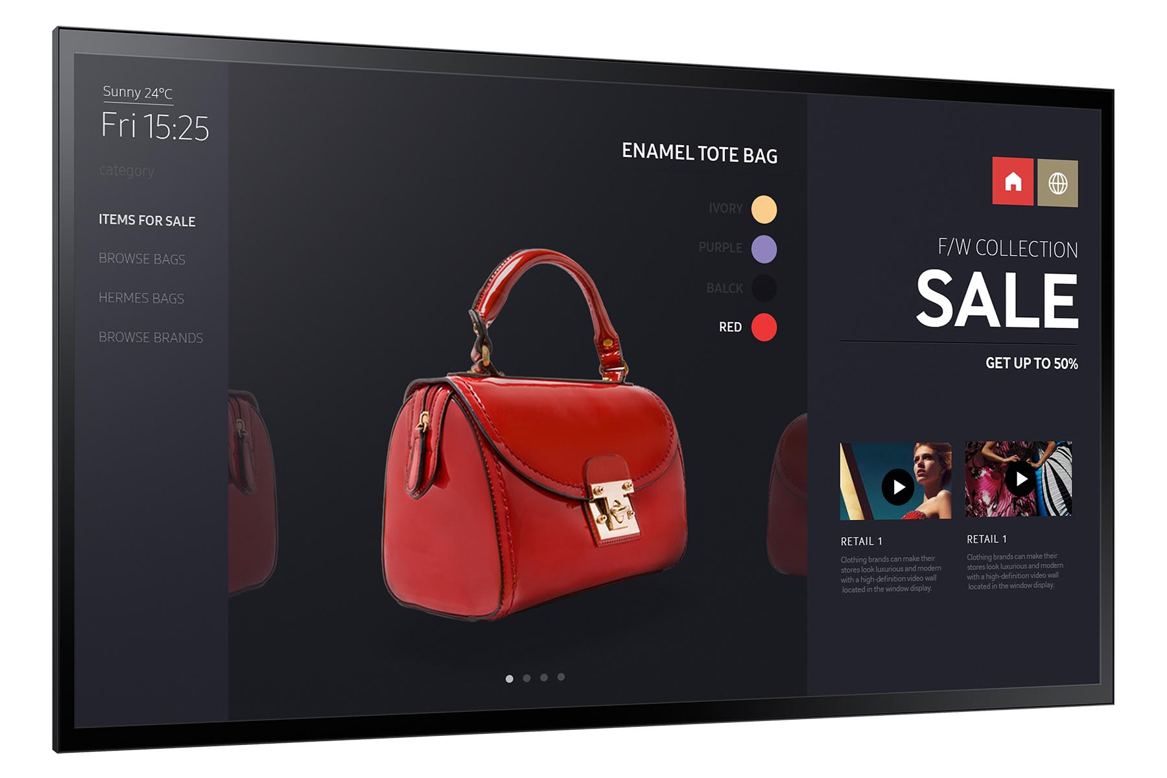
PMF-BC Series
PM32F-BC (32”), PM43F-BC (43”), PM55F-BC (55”)
Advanced 24/7 rated interactive LFD. Includes the newest 4th generation Tizen based SoC (System on a Chip) media player and factory integrated capacitive touch.
Key Features:
1920x1080 Full HD resolution
Slim direct lit 24/7 LED display - 32” 300nit, 43” 350nit, 55” 400nit
32” - 21.9MM bezel width
43” - 20MM (Side), 25MM (Top/Bottom) bezel width
55” - 17.9MM (Side), 25MM (Top/Bottom) bezel width
Factory integrated 10-point capacitive touch
SSSP 4.0 / S4 Player (SoC) onboard
Wi-Fi onboard with integrated Miracast screen mirroring
IP5X rated for dust
Notes:
Additional Specs
Matte screen surface (touch glass)
2.4” chassis depth (55” 7.9”)
Integrated TV Tuner (NTSC/ATSC/Clear QAM)
Integrated speakers
DVI-D, HDMI 2.0 (2), DisplayPort 1.2 inputs
Videowall processor up to 15x15
Videowall loop through (DisplayPort) up 10x10 in 1080P with HDCP support (up to 7)
RS232 and IR loop through
Full RS232 and IP control
Wi-Fi or Ethernet networking
3-year onsite commercial warranty

Slide 44
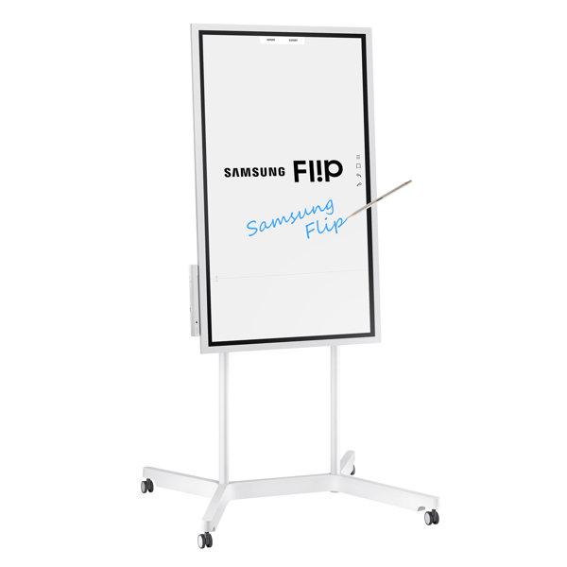
WMH Series - FLIP
WM55H (55”)
An interactive digital flipchart designed for creative thinking, collaboration and innovation
Key Features:
3840x2160 4K UHD resolution
300nit edge lit 16/7 LED display
Factory integrated advanced IR 4-point touch
Included Flip collaboration software
Full touch control
Wi-Fi and NFC onboard with integrated Miracast screen mirroring (input and output)
Side USB input
Includes 2 passive pens
Flip Stand: STN-WM55H
Notes:
Additional Specs
FTIR touch technology
Matte screen surface (touch glass)
Sensor for rotation
2” chassis depth
Integrated speakers
1 HDMI (rear) 1 USB (rear) 1 USB (side)
USB out for touch overlay (rear)
Wi-Fi and Ethernet networking
Limited IP control, no RS232
3-year onsite commercial warranty

Slide 45
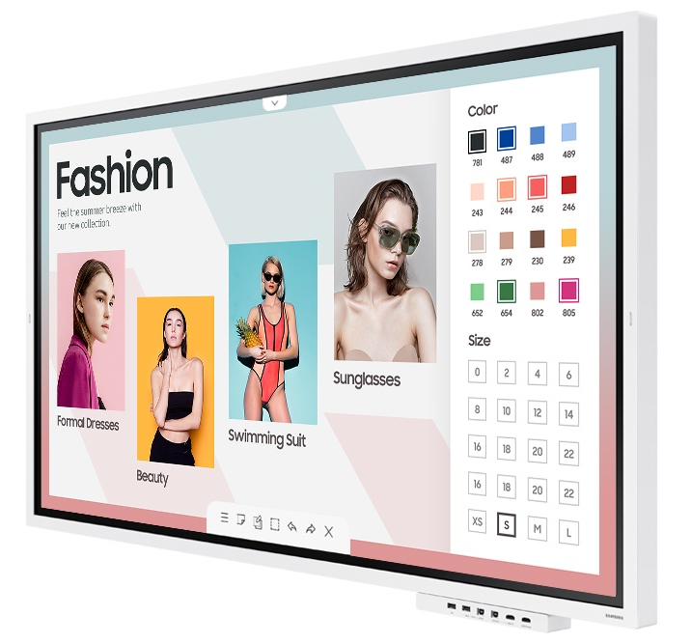
WMR Series - FLIP
WM65R (65”)
An interactive digital flipchart designed for creative thinking, collaboration and innovation
Key Features:
3840x2160 4K UHD resolution
350nit edge lit 16/7 LED display
Factory integrated advanced IR 4-point touch
Included Flip collaboration software
Full touch control
Wi-Fi with integrated Miracast screen mirroring (input and output)
Includes 2 passive pens
Input Tray: CY-TF65BRCXZA
Wall Mount: WMN-WM65RXZA
Notes:
Additional Specs
FTIR touch technology
Matte screen surface (touch glass)
Sensor for rotation
2” chassis depth
Integrated speakers
2 HDMI (rear), 1 USB (rear), 1 audio output (rear)
Input tray adds 3rd HDMI input, HDMI output, 2nd USB input, 2nd USB touch output, and USB upstream in/out. NFC pairing on tray
USB out for touch overlay (rear)
Wi-Fi and Ethernet networking
Limited IP control, no RS232
3-year onsite commercial warranty

Slide 46
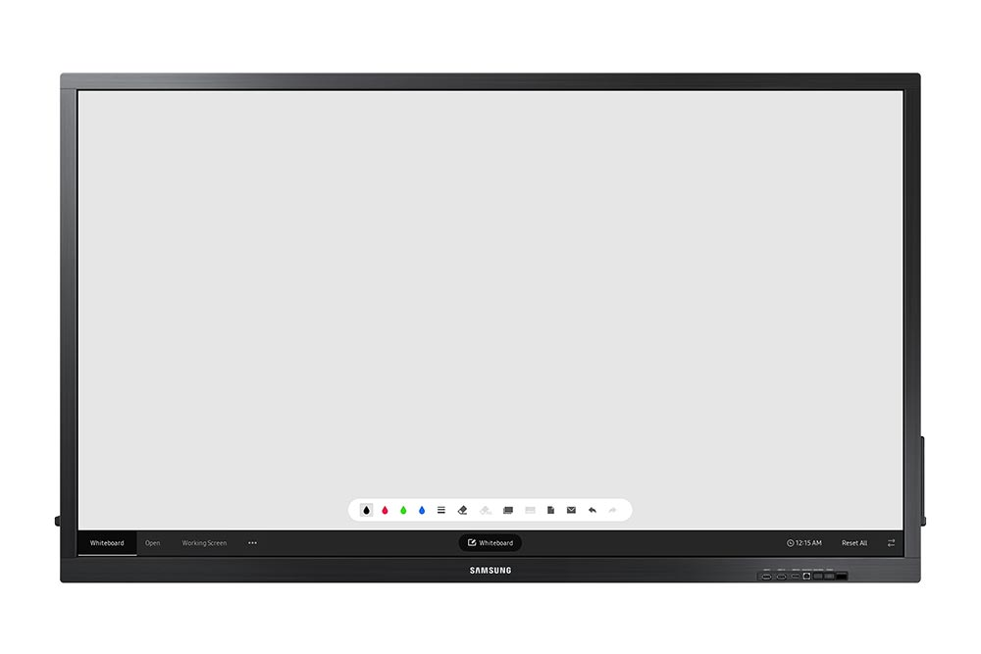
QBN-W Series
QB75N-W (75”)
Robust, all-in-one E-boards that feature enhanced touch technology and UHD picture quality
Key Features:
3840x2160 4K UHD resolution
300nit direct lit 16/7 LED display
Factory integrated IR touch
10 point with external devices
4 point with SoC
(SoC) onboard with Tizen 3.0, included MagicIWB S5 whiteboard software
Wi-Fi onboard with integrated Miracast screen mirroring
Front video and USB inputs
Includes passive pen
Notes:
Additional Specs
Matte screen surface (touch glass)
3.4“ chassis depth
Integrated speakers
2 HDMI 2.0 (rear) 1 HDMI 2.0 (front), DVI-D
USB out for touch overlay (1 rear 1 front)
Full RS232C and IP control
3-year onsite commercial warranty

Slide 47
Specialty LFD

Slide 48
SHF Series
SH37F (37”)
Ultra-wide format stretch LFD for digital signage.
Key Features:
1920x540 resolution
Stretch form factor
700nit slim direct lit 24/7 LED LFD
12mm (T/B), 5.7mm(L/R) bezel width
SSSP 3.0 / S3 Player (SoC) onboard
Wi-Fi onboard
Notes:
Additional Specs
Matte screen surface (44% matte)
1.6” chassis depth
Integrated speakers
VGA, DVI, HDMI, Comp./CVBS inputs
Full RS232 control
Videowall processor
Videowall loop through (DisplayPort)
3-year onsite commercial warranty

Slide 49
LFD Accessories

Slide 50
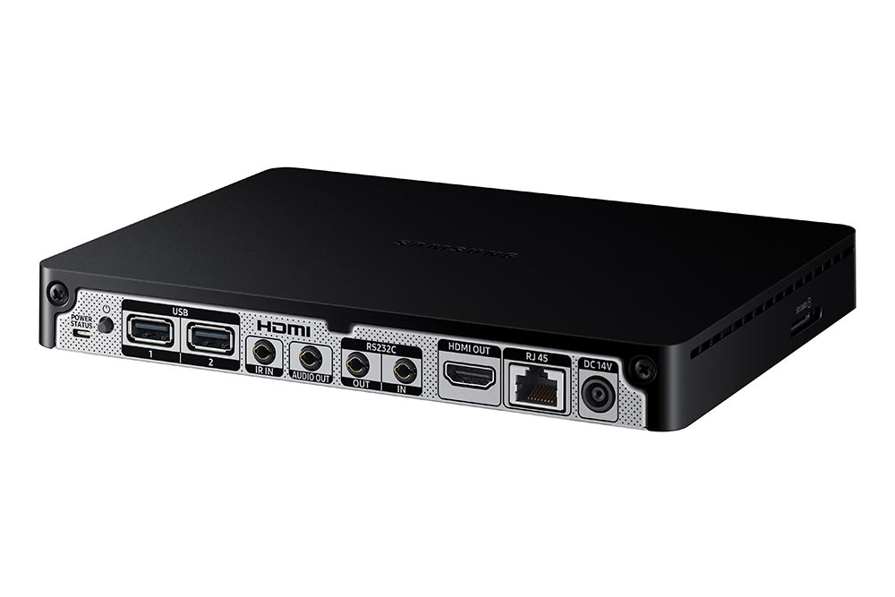
Signage Player Box
External slim set back box for compatible LFD displays and videowalls.
SBB-SS08NL1: S6 Player (Tizen), SSSP 6.0, 8GB storage, 2x USB
Contains full Samsung SoC for MagicInfo Premium S, capable of 4K UHD
Connects to the display or videowall using HDMI cable.
Requires second power input.
Full IR remote control (with external receiver) and RS232.
Wired Ethernet networking ONLY
Comes with bracket to attach to the back panel of Samsung LFDs.
Notes:
Unlocked for use with any display device.

Slide 51


Optional Touch Overlays – TSi Touch
TSI Touch provides optional touch screen overlay solutions, which allow for a high accuracy interactive experience.
Multi-Touch - true multi-touch support with up to six simultaneous touch points for all major operating systems
Ultra-Fast Response Time - allows for split second reactions between touch point and screen
Superior Design - full steel chassis combined with anti-reflective tempered glass provides additional protection to the LCD panel
Easy Integration - unrivaled simplicity makes installation easier and faster
HID Compliant - maximum compatibly with numerous operating systems, plug-and-play
Customizable - custom colors and silk screening available

Slide 52
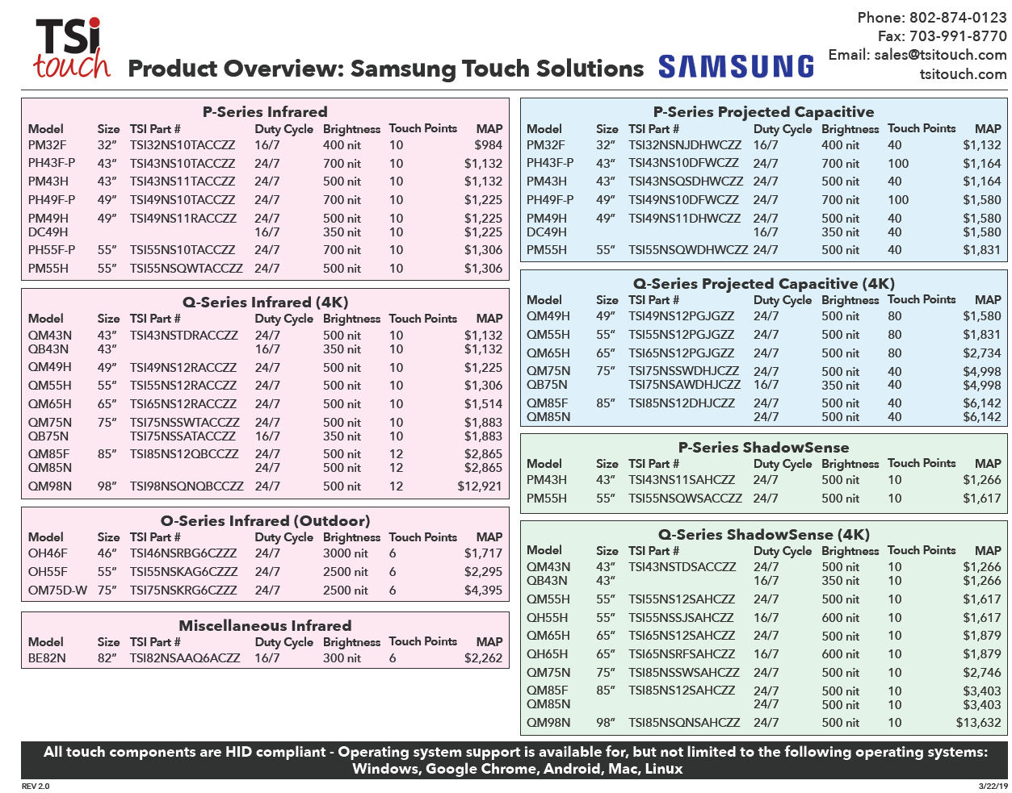
Optional Touch Overlays – TSi Touch

Slide 53
LFD Features

Slide 54
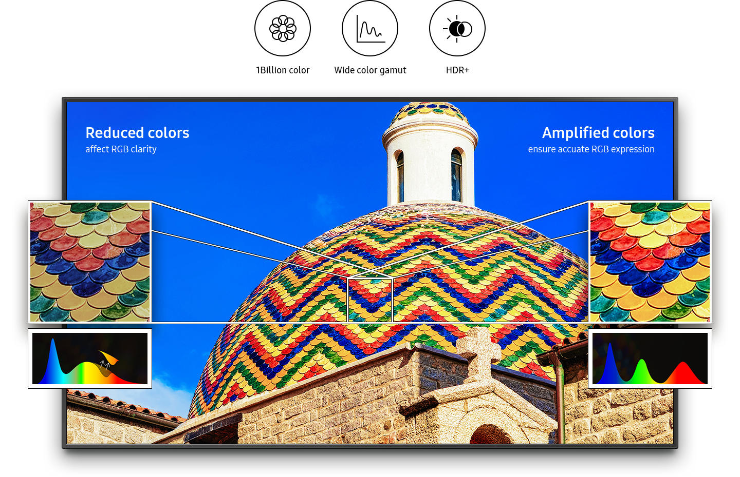
Dynamic Crystal Color
Experience crystal clear, lifelike color with up to a billion shades of color—64 times more than conventional UHD displays. QBR, QER, and QMR Series displays deliver picture-perfect results virtually every time, so you can see every color in a rainbow or every shade in a spectacular sunset.
Experience superior brightness, greater detail in blacks, and authentic color with HDR powered by HDR 10+.

Slide 55
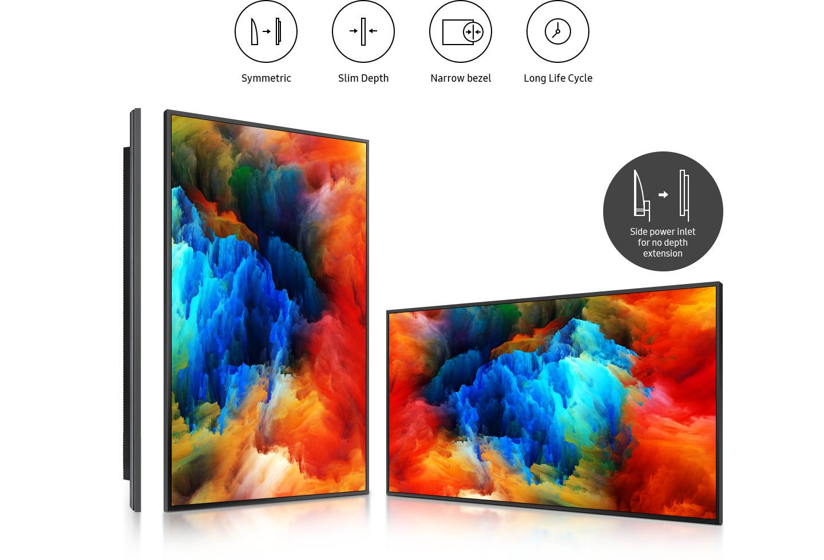
Slim and Symmetrical Design
The QBR and QMR series features an all-new symmetric design simplifying wall mounting and ensuring installation is seamless. The flat back and slim depth will ensure a display that will stand the test of time.

Slide 56
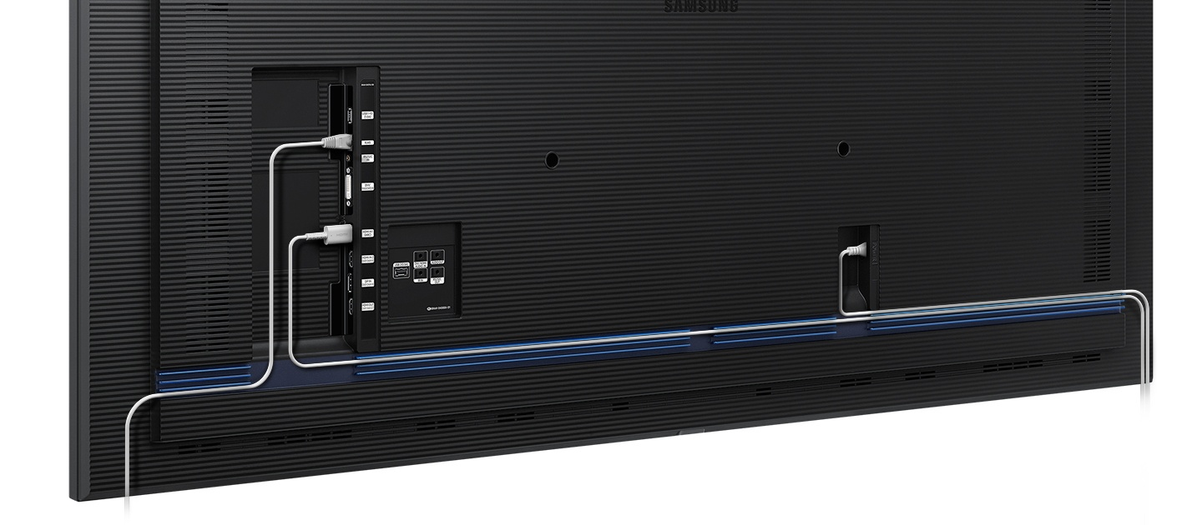
Clean Cable Management
In a corporate or retail environment, the back of a display is often visible to customers. With the QBR and QMR series’ new cable guide feature, users can tuck messy cables away from view. This allows for a clean and more visually-appealing customer experience.

Slide 57
Cisco Certified Compatible Display
The QBR and QMR Series are fully compatible with Cisco WebEx® Room Kit products.
The Cisco WebEx Room Kit is a powerful video collaboration tool that integrates a camera, codec, speakers and microphones into a single device.
Combined with Samsung’s displays, you get a powerful conferencing solution for your business.

Slide 58

Powerful, All-in-one Digital Signage Solution
Samsung's SMART Signage Platform and the embedded MagicINFO Player, backed by the powerful Tizen operating system, boosts your displays' overall performance through System-on-Chip (SoC) technology and allows for easy content management and playback, without the need for an external set-back box or PC.
CPU
1GHz Quad Core Processor (S3)
1.3GHz Quad Core Processor (S4)
1.7GHz Quad Core Processor (S5/S6/S7)
Memory
1.5GB DDR3 (S3)
2.5GB DDR3 (S4)
3.0GB DDR3 (S5/S6/S7)
Video Processor
Full Codec, High Performance WMV, MP4, H.264, H.265
Storage
8GB SSD (4GB Available to User)

Slide 59

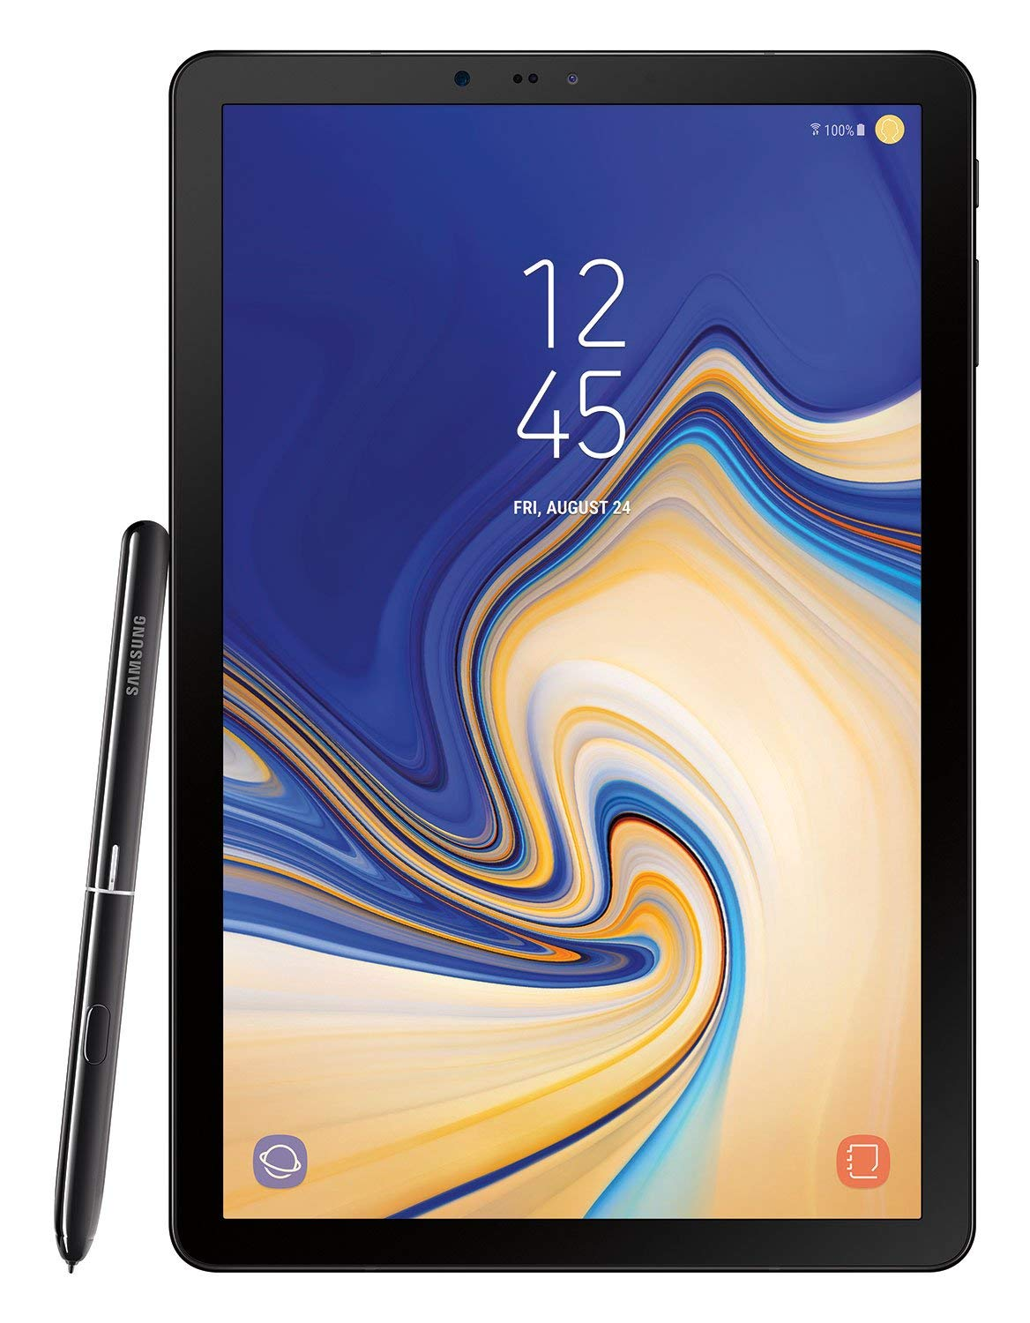
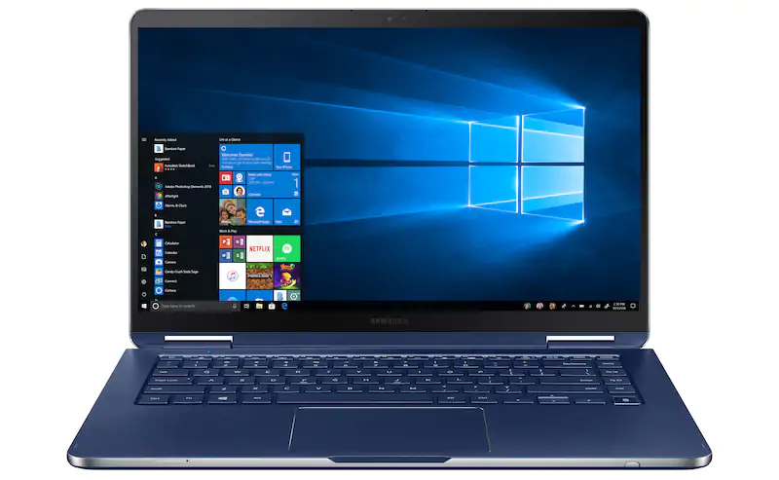
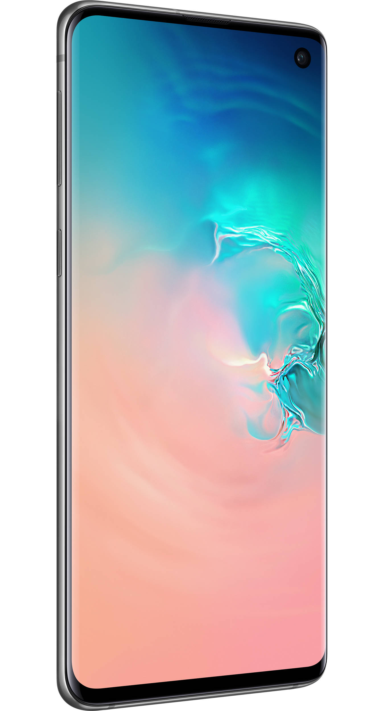
Integrated Wi-Fi
Samsung SoC equipped commercial LFDs feature built in Wi-Fi capability for easy wireless connectivity.
Wi-Fi onboard provides wireless networking for MagicINFO and SSSP applications, as well as IP control of connected panels.
Wi-Fi enabled Samsung LFDs integrate Miracast for screen mirroring with compatible mobile devices.

Slide 60
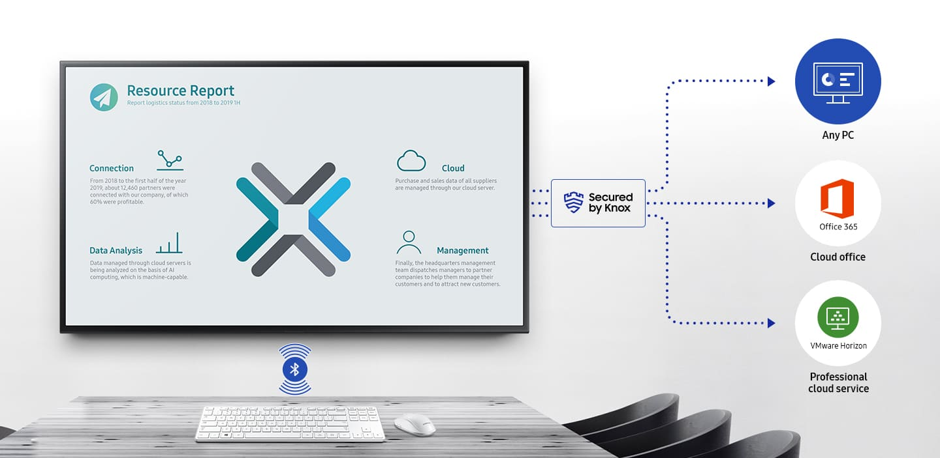
Remote Access / Workspace
With security provided by Knox, QER and QPR-8K displays now feature Remote Access which supports wireless cloud service access and control of a PC without needing a physical connection. Remote Access simplifies meeting spaces while also improving security.
QBR and QMR series displays offer Remote Workspace, which utilizes Knox secured connections to provide remote control of any PC on your network.

Slide 61
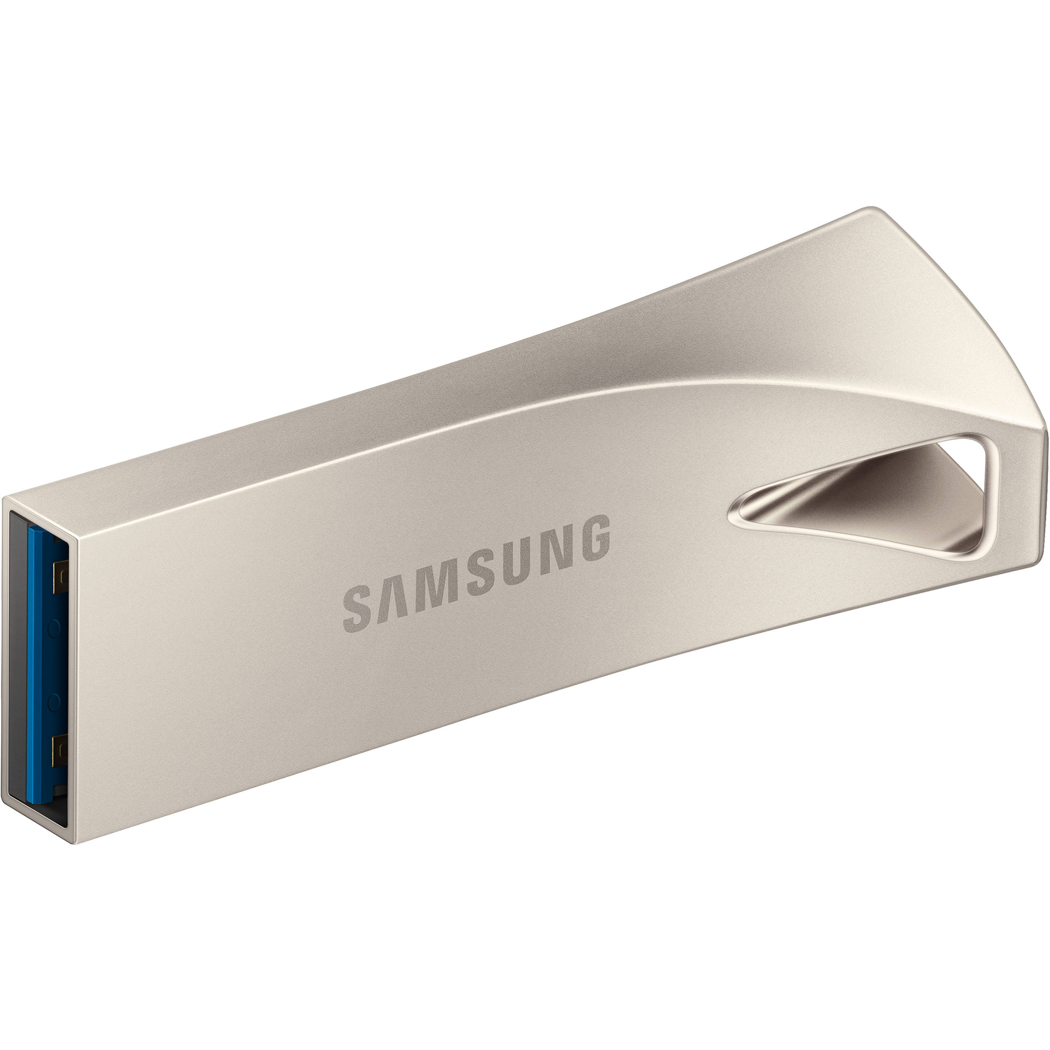
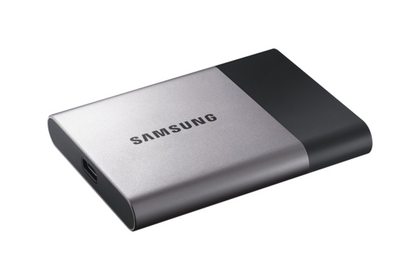
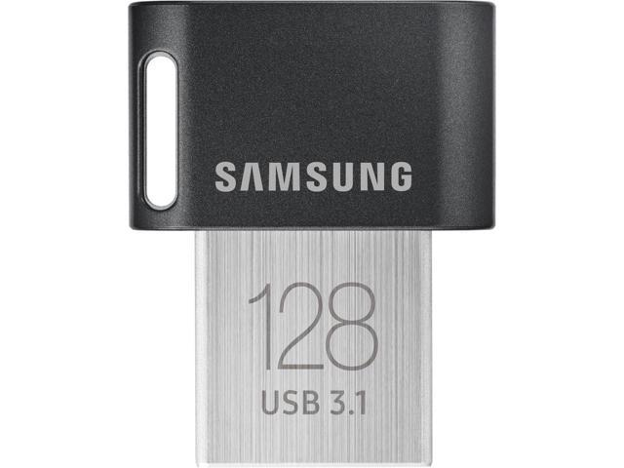
Expandable Storage
All SoC equipped displays may also utilize onboard USB ports to add storage.

Slide 62
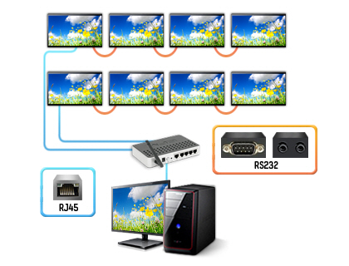
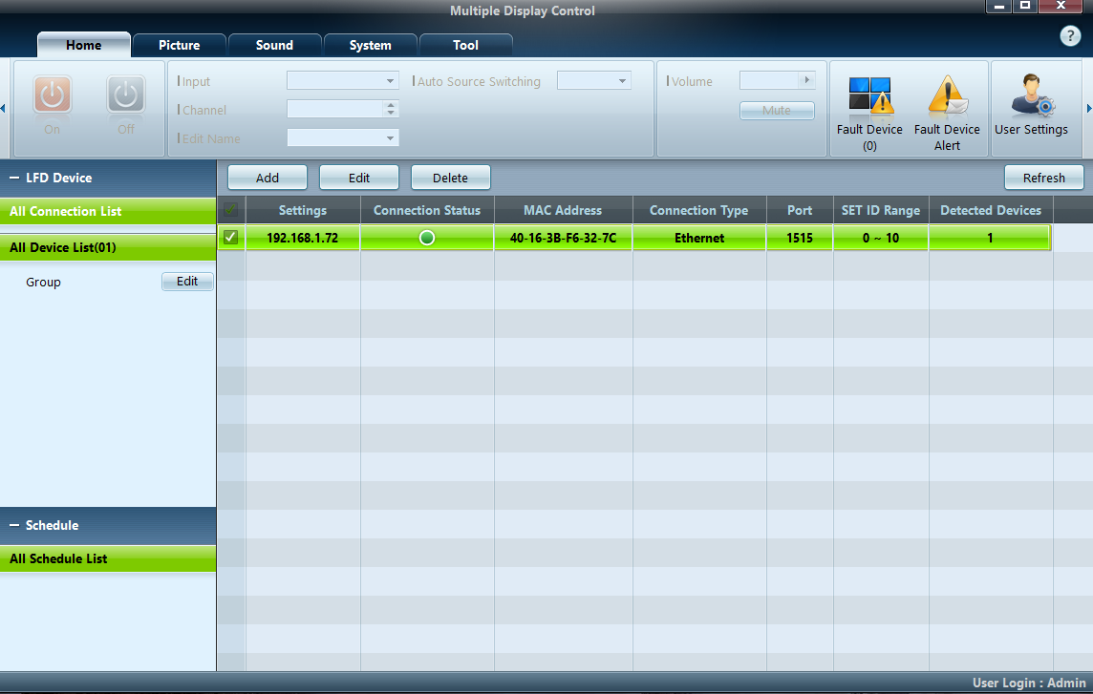
Multiple Display Control (MDC) System
Samsung MDC (Multiple Display Control) is both the protocol for RS232 and IP control, and free control software application.
Each display has a built in RS232 input (DB9 or stereo mini plug) or can accept RS232 commands via IP over a network from the onboard RJ45 port or Wi-Fi connection.
The free Windows-based MDC control software can be used to control one or more LFDs simultaneously on a single network.

Slide 63
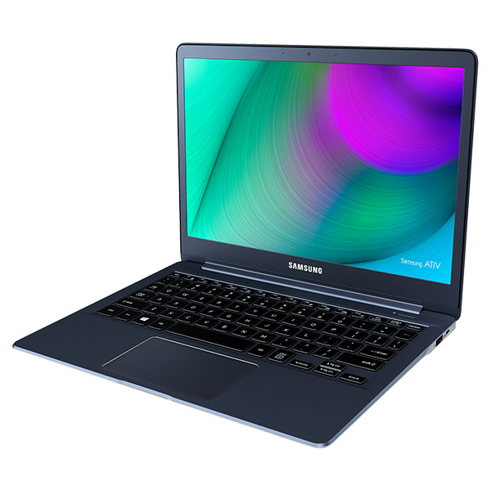




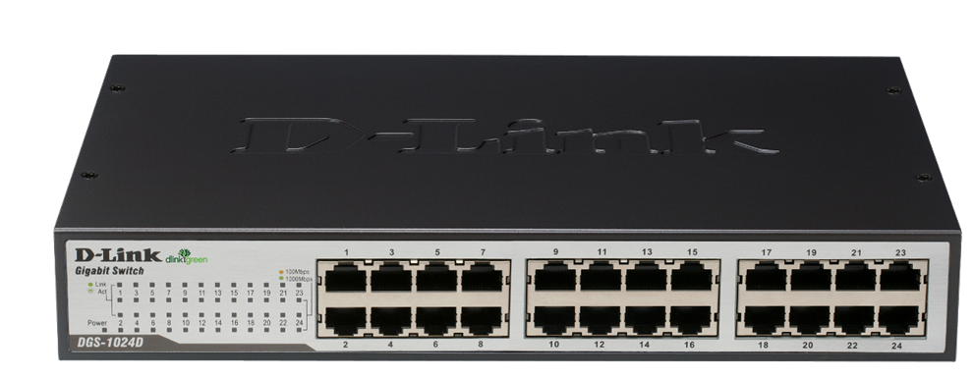

Multiple Display Control (MDC) System
LFDs can also loop out to local RS232 from IP connections, using on board daisy chaining.
LAN
AREA 1: Enough IP Addresses / Connections
IP : 10.88.1.1
RS232C
LAN
LAN
LAN
AREA 2: No LAN but local to a PC
AREA 3: Limited IP Addresses / Connections
RS232C
IN/OUT
RS232C
IN/OUT
RS232C
IN/OUT
LAN
RS232C
IN/OUT
RS232C
IN/OUT

Slide 64
Power Automation Timers
Samsung’s multi-part timer system provides an easy way to set automatic on/off and input modes of a display. 7 separate timers with a holiday compensation setting may be employed.
Timer 1
Mon ~ Thu (09:00 ~ 22:00)
Input : DVI
Volume : 60
Holiday Opt.: APPLY
Timer 2
Fri (09:00 ~ 20:00)
Input : PC
Volume: 90
Holiday Opt.: APPLY
Timer 3
Sat/Sun (10:00 ~ 18:00)
Input : MAGICINFO
Volume: 100
Holiday Opt.: NOT APPLY
MON
THE
WED
THU
FRI
SAT
SUN
8
9
10
11
12
13
14
TIMER #1
TIMER #2
TIMER #3
15
16
17
18
19
20
15
TIMER #1
TIMER #2
TIMER #3
POWER TURNED OFF!!
(Holiday option)
POWER KEPT ON!!
(NO Holiday option)

Slide 65
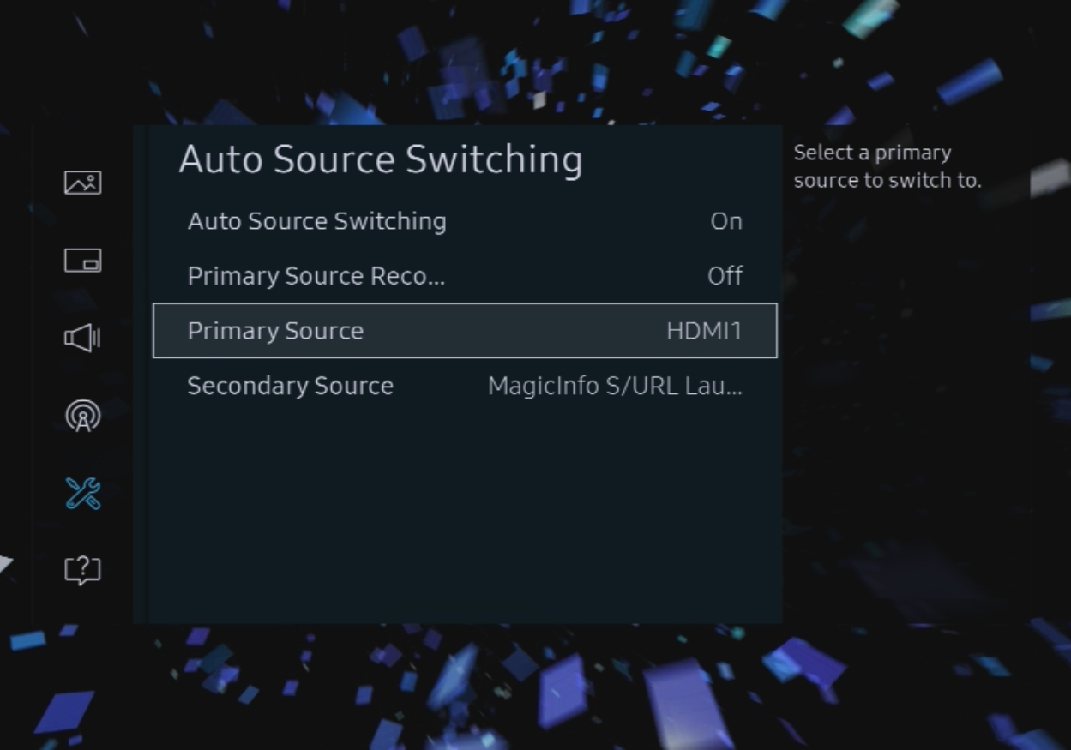
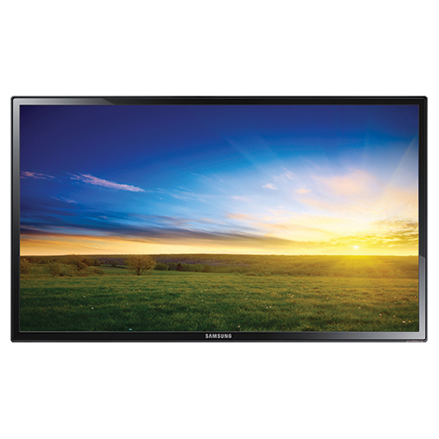
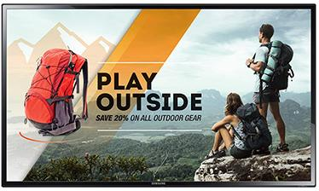
Automatic Source Switching
Samsung commercial LFDs feature an automatic source switching feature.
Each display can be set with a primary and secondary source.
When the primary source no longer sends a signal to the display, it will automatically switch to the configured secondary source input.
Primary
Secondary
Primary
Secondary

Slide 66
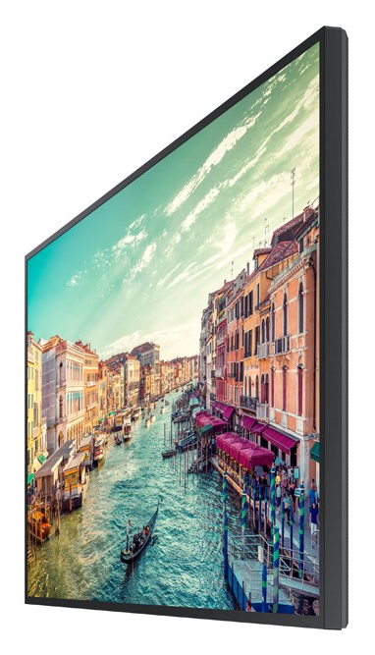
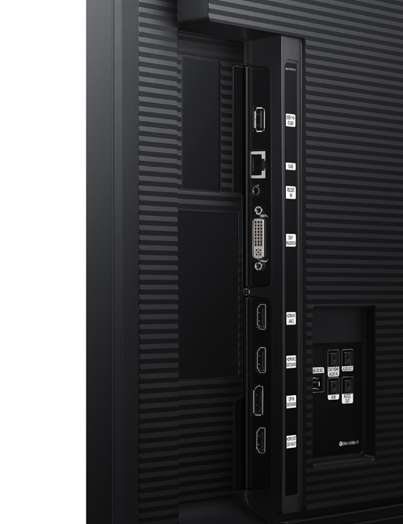
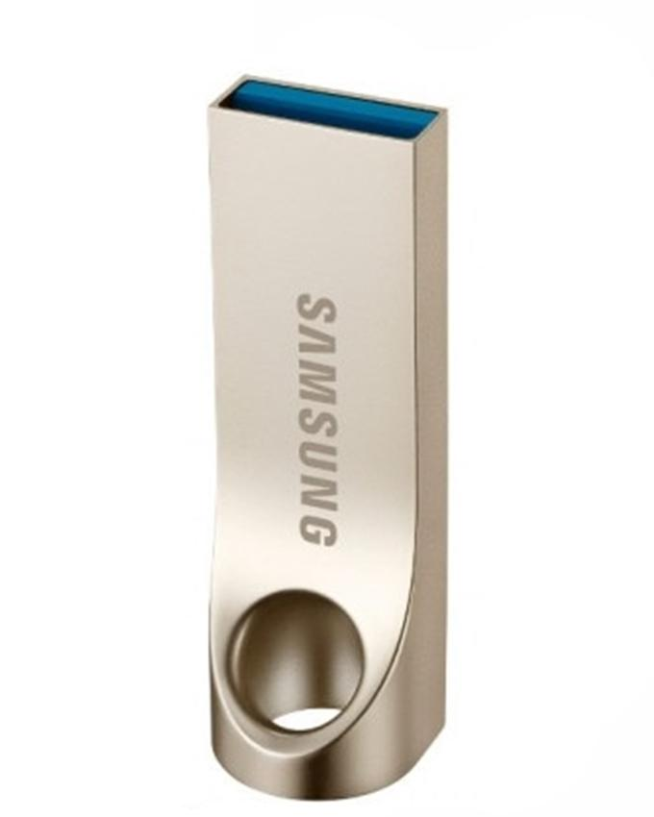
MagicClone
Configurations of one LFD can easily be copied to many others, using the onboard MagicClone system and a USB flash drive.
MagicClone will copy all user menu settings from one display onto the flash drive, which can be copied to any other LFD from the same series.

Slide 67

PC-Less Touch
LFD system menus, MagicInfo Premium S, and SSSP software can utilize a USB connected touch overlay through the onboard SoC.

Slide 68
Center IR Receiver
PMF / PHF-P / QER / QBR / QMR / QMN series LFDs integrate a center infrared (IR) receiver into the display glass, for easier and more flexible user control.

Slide 69
IP5X Dust Rating
All of Samsung’s PMF / PHF-P / QBR / QMN / QMR standalone displays and OMF / OMN semi outdoor displays are IP5x certified, signifying their dust-resistant design and ability to withstand a range of environmental conditions.
Customers can conveniently use this IP5x certified display without needing to prepare additional enclosures in dusty places.
Uninterrupted, 24/7 content delivery is always assured regardless of surrounding natural or interactive conditions.

Slide 70
Outdoor /
Semi- Outdoor
LFD Features

Slide 71

High Brightness
Samsung outdoor and semi-outdoor LFDs feature high screen brightness, for high ambient light and sunlight environments.
Typical LFD: 300-700 nits
OMH: 1000 nits
OMD-W: 2500 nits
OHF: 2500 nits
OMN-D: 3000/1000 nits
OHN-D 3000 nits
OMN: 4000 nits

Slide 72

IP Ratings
OHF / OHN-D series LFDs feature IP56 rating for outdoor use without the need for an IP rated enclosure.

Slide 73

Integrated HDBase-T
OMH and OHF series LFDs feature an integrated HDBase-T input, removing the need for an external receiver.
This provides for easier installation and signal distribution, allowing the source to be placed up to 100M (330FT) away from the LFD.

Slide 74


Protection Glass – OHF / OHN-D Series
Additional display protection is provided through the 5 mm (0.19 in.) tempered Reflection Cancelling Protection Glass that can resist the free dropping of a 0.54 kg (1.19 lb.) metal ball from up to 2.5 meters (8.2 ft.).
2.5meters are Samsung's higher standard of protection glass than industry standard 1.5meters.
In addition, a gap between the Reflection Cancelling Protection Glass and the LCD panel prevents LCD breakage when the protection glass is broken (unlike optically bonded panels, which are more easily broken).

Slide 75
Flip Features

Slide 76

Flip Touch
Samsung Flip is the ideal forum for simultaneous interaction.
Up to four different meeting participants can make notes using the embedded pen or virtually any writing tool.
Additionally, you can sync and control content from your personal device to the central screen for efficient collaboration.

Slide 77




Flip Design
Whether for a quick discussion or lengthy presentation, meeting notation no longer needs to be uncomfortable.
Customize and work within your ideal writing dimensions.
Leverage the optimized pivot height to automatically align the Flip to an ideal level.
Utilize the ergonomic 4.5-degree tilt in portrait mode for a more natural writing angle.
And configure the display in portrait or landscape orientations to maximize available writing space.
4.5˚
Easy moving 4-wheel
Convenient pen holder
Spacious tray
4.5° tilt in portrait mode

Slide 78

Flip Design
The workday is busy, and you cannot afford to lose any time.
The Samsung Flip accommodates these demands and ensures that meetings start on time.
Embedded sensors automatically activate the display when you approach or remove the pen from the holder.
Samsung Flip also stores meeting notes in real-time, preventing the need to stop conversation to save each page.
Tizen
Sensor based
Internal storage

Slide 79


Flip Design
The Samsung Flip enables you and your colleagues to bring your unique style to the conversation.
The display showcases smooth, fast writing in a variety of colors and depths, with compatibility for multiple writing tools.
Need to erase a previous note? You can quickly clear either a small section or full screen worth of content using a hand swipe motion.
Passive pen
Smooth & fast
Flexible erasing

Slide 80


Flip Connection
Standard meeting technologies make it difficult to locate the input sources required to connect external devices.
Samsung Flip’s versatile connectivity makes dedicated USB, note PC, and tablet and mobile devices ports readily available, saving valuable meeting time while extending participation capabilities

Slide 81

Flip Synchronization
Today’s workers rely on their mobile devices to stay productive more than any other workplace tool.
The Samsung Flip supports the mobile movement through extensive connectivity that makes on-screen content visible without interruption.
And through integrated NFC and screen mirroring technologies, participants can mirror materials directly from their smartphone onto the central screen.

Slide 82

Flip Navigation
You and your colleagues no longer have to sort through stacks of paper charts to find specific ideas or conversations.
Samsung Flip eliminates this tiresome process by housing all meeting notes in a central storage database, with convenient search and navigation functionalities capable of locating a specific item in seconds.
Detailed previewing also shows how a recap will look before it is shared with live and remote participants.

Slide 83

Flip Presentation
The Samsung Flip offers added flexibility for a flawless presentation in any desired format.
Regardless of huddle room dynamics, you and your colleagues can showcase content in portrait or landscape mode thanks to convenient pivot functionality.
The Samsung Flip also upholds steady organization through clear page dividers, with the ability to quickly scroll through up 20 pages at a time.

Slide 84

Flip Presentation
If you have ever had to capture handwritten meeting notes or send a detailed recap to your team, you understand how frustrating wrap-up can be. Samsung Flip eliminates the need for this cumbersome process through easy storage and distribution.
Now, you can instead send digital notes to your colleagues via email, printing, and network or USB storage, saving time while also preventing important ideas from being erased, ruined or lost.

Slide 85
Flip Presentation
Although the Samsung Flip allows for many users and access points, it also ensures that confidential meeting information re- mains in the right hands.
Trust the Flip’s airtight, password-based security system to safeguard your most important documents.
The result is a more free and boundless exchange of ideas that any business can benefit from.

Slide 86
e-Board LFD Features

Slide 87

Enhance Touch, Enhance Capacity
Leverage heightened touch functionality for a smooth and versatile digital writing experience.
Up to 4 users can write simultaneously using the provided pen, or virtually any other tool.

Slide 88

Elevate Collaboration Quality
The embedded MagicIWB S5 solution facilitates discussion management and organization with an intuitive interface for quick access to vital collaborative functionalities such as screen mirroring and real-time notation.

Slide 89

Switch Sources Seamlessly
Through the Working Screen function, users can quickly switch between multiple screens, such as the whiteboard, internet browser and connected input sources, with just a few touches.

Slide 90

Retrieve / Control Content Remotely
Pull and edit content on remote laptops directly through the central screen utilizing touch functionality. The powerful Knox system secures the Remote Workspace connection to protect against information leakage and meddling.

Slide 91

Connect with Convenience
Each e-board offers a wide range of connections including HDMI, DVI-D, DP and USB ports, where users can load, share and revise content directly from their personal devices.

Slide 92

Maintain Organization with Style
Drive more organized collaboration with a sleek, sophisticated design. The magnetic side pen holder and frontal connection ports keep needed functions within reach, without the mess.

Slide 93
Videowall LFD Features

Slide 94

Built in Videowall Processor
Samsung commercial LFDs feature a built in videowall processor for multi-display configurations.
This allows for up to a 15x15 array (10x10 via daisy chain, depending on model) of LFDs to be connected, using the onboard processor, to create a single image across the entire array.
The onboard processor provides a low-cost way of constructing basic videowalls quickly and easily.

Slide 95




Example Loop Through Videowall – 2x2
4x LFDs
4x DisplayPort / HDMI M-M cable
4x Videowall mount
Digital source
3
4
Digital video source connected to LFD 1
2
1
DisplayPort / HDMI M-M from loop through output to DisplayPort input on LFD 2-3-4
Source

Slide 96


How the Loop Through Works
The source is connected to the first display, and then daisy chained using DisplayPort or HDMI male-male cables to the other displays in the wall.
The source can be connected via any digital input.
Source

Slide 97


How the Loop Through Works
The daisy chain processor is configured in the display’s onboard menus. This can be done via IR remote, RS232, or IP.
The display’s videowall processor is turned on, and the display is told how many LFDs are in the wall, horizontal and vertical.
The display is told where it is in the wall by using the screen position control.
The daisy chain processor will allow the display to accept the video input, scale it to size for the wall, and break out the portion of the image for that individual monitor.

Slide 98
How the Loop Through Works
Each monitor will then display only its portion of the source input, creating a single large image across the entire wall.

Slide 99



Design Considerations for Videowalls
Resolution
The daisy chain processor is designed to handle only the native resolution of a single LFD.
UDE, UHF5, and UHE LFDs can address an input up to 4K UHD despite being native 1080P.
Content
Only a single fixed source may be shown.
External switching may be required to add additional sources.
Aspect Ratio
The daisy chain processor is designed to handle 16:9 aspect ratio scaling only.
Daisy chain systems must be kept linear, keeping the same number of monitors horizontal and vertical, i.e. 2x2, 3x3, 4x4.
Non-linear configurations (2x3, 4x6, 1x5) will cause content to be stretched.
1920x1080
1920x1080

Slide 100

UHD Loop Through
UHF5, UDE, UHF-E, UMH-E, UHN-E, UMN-E, and VRM-U series LFDs can accept up to 4K UHD resolution input for videowalls.
This increases the input resolution of videowalls created using the onboard processor from 1080P to 4K across the entire array, up to 5x5.

Slide 101



Color Expert Pro Technology
Samsung’s Color Expert Pro technology is a cutting-edge solution that allows users to ensure vibrant, uniform picture quality across their displays – even after installation. The technology is the last step in the rigorous three-part approach that Samsung takes to make sure that all its displays exude highest picture quality.
Factory Calibration
Samsung’s multistep factory tuning works to enable uniform brightness and color across video wall displays.
ACM Chipset
ACM IC is embedded to enable more delicate and accurate calibration than conventional solutions.
Color Expert Pro Software
Allows users to more finely tune color and other attributes after factory calibration and installation for even better performance.

Slide 102

Factory Brightness Uniformity Calibration

Slide 103



Samsung Color Expert Software
Samsung Color Expert Pro software allows users to calibrate the color settings after installation for absolutely accuracy.
Provided at no charge, Samsung Color Expert Pro enables the user to more finely adjust local uniformity, white balance and gamma calibration simply and intuitively.
The user will need to supply a compatible colorimeter, which will connect to a computer via USB. A Samsung cell phone (S7 and newer) may also be used (with an Android app).

Slide 104
Samsung SMART Signage Platform (SSSP)

Slide 105

The Samsung Smart Signage Platform
An integrated system that simplifies the transition to digital signage by:
Eliminating the need for external media players
Streamlining deployment and installation
Providing an open platform to the digital signage software community, allowing development of customized signage solutions

Slide 106

How Does it Work?

Slide 107







Expanding the Software Ecosystem
Samsung has provided an open platform in the SSSP to allow for top content management software (CMS) vendors in the digital signage universe to develop versions of their products that will run on the embedded media player.

Slide 108
MagicInfo
Products and Licensing

Slide 109

MagicInfo – 4 Turnkey Signage Solutions
Samsung has developed a family of turnkey software solutions called MagicInfo, as part of their commercial LFD product line
To address different levels of application requirements, there are 4 different versions of MagicInfo solution.
MagicInfo Express 2
MagicInfo Lite
MagicInfo Premium S
MagicInfo Premium I

Slide 110


MagicInfo Express 2
Basic digital signage, that does not require a separate media player, provided at no additional cost.
MagicInfo Express 2 runs on the SoC in S3/S4/S5/S6 Player LFDs.
Express 2 software can be installed on Windows, Mac, Android, or iOS.
Express 2 connects to the LFD via a network. If no network is present, a direct Wi-Fi connection can be set up on the LFD (Soft Access Point).
Express 2 can also publish content via USB storage devices.
Plays photos, videos, PowerPoint, PDF, external sources (via PiP), and allows for multi-zone template creation from a library of pre-created layouts.
No license required.

Slide 111


MagicInfo Lite
Basic digital signage, that does not require a separate media player, provided at no additional cost.
MagicInfo Lite runs on the onboard SoC (System on a Chip) within Samsung commercial LFDs.
Utilizes a standard IP network (wired or wireless).
Plays photos, videos, Flash, PDF and PowerPoint, in full screen only.
Uses MagicInfo Server 6 for centralized management of LFDs.
Includes 25 free licenses with the install of the Server software.
Additional licenses can be purchased with part number CY-MILSSTS. Each display added must have a license.

Slide 112

MagicInfo Premium S
Premium digital signage that does not need a separate media player.
MagicInfo Premium S runs on the onboard SoC (system on a chip) within Samsung commercial LFDs.
Utilizes a standard IP network (wired or wireless).
Offers custom multi-zone template capability and embedding PiP to add live video to templates.
Compatible with MagicInfo Premium Author software for advanced template creation.
Uses MagicInfo Server 6 for centralized management of LFDs.
One license is required per display, part number BW-MIP40PA.
There is a 60-day trial for up to 5 monitors available on the server software.

Slide 113

MagicInfo Premium I
Samsung’s flagship digital signage solution offering the most features and capabilities.
MagicInfo Premium I requires use of small form factor PC connected to the LFD to act as a media player.
Utilizes a standard IP network (wired or wireless).
Offers custom multi-zone template capability and embedding PiP to add live video to templates.
Compatible with MagicInfo Premium Author software for advanced template creation.
Uses MagicInfo Server 6 for centralized management of LFDs.
One license is required per display, part number BW-MIP40PA.
There is a 60-day trial for up to 5 monitors available on the server software.

Slide 114

The MagicInfo 6 Server
The MagicInfo Server is a browser-based software system that manages and controls content and devices, allowing the user to organize and publish content.
The MagicInfo Server is on-premise software (self hosted) using a Windows based PC.
The user accesses this software from a standard web browser, connecting to the server PC over the network, or the Internet.
Because the system is designed to be web based, a user can connect to the server and interact with it remotely.
MagicInfo Server supports multiple LFDs across multiple sites, with multiple users, and does so simultaneously.

Slide 115
For more information, contact your local Samsung representative, or Brawn Consulting:
1 (866) 754-6450
samsunglfd@brawnconsulting.com
Jonathan Brawn
Principal
Brawn Consulting
E: jonathan@brawnconsulting.com
Brian Kosich
Engineering Services Manager
Brawn Consulting
E: brian@brawnconsulting.com
Thanks for Attending!

